Slide 1
Lecture 7
STAT 451 VISUALIZING DATA
Fall 2025
Many thanks to Prof. Abel Rodriguez, many slides from this course are adapted from his data visualization class.

Slide 2
Case studies
There are some “special cases” that appear over and over in visualization problems. We will study some of them in a lot of detail.
There are some choices of visual cues and coordinate systems that are often made for decorative purposes but are suboptimal.

Slide 3
COMBINING TIME SERIES AND PART-TO-WHOLE RELATIONSHIPS

Slide 4
Combining Time Series and Part-to-Whole Relationships
Part-to-whole data refers to values that combine to form a whole compare to one another and the whole.
Time series data refers to how values evolve over time.
In combining time series and part-to-whole data we aim at showing how both the individual parts and the whole evolve over time.
Time series of sales broken down by district.
Weekly box-office receipts from different movies.

Slide 5
An example: Sales data
Consider the following table containing the dollar value of sales made by four divisions of a firm:
What are natural questions to ask about this data?
Have total sales gone up or down?
Has the contribution of any particular division to total sales gone up or down?
Hard to see from table, let’s use a visualization!
Region | Jan | Feb | Mar | Apr | May | Jun | Jul | Aug | Sep | Oct | Nov | Dec
East | 64,162 | 70,172 | 93,657 | 55,056 | 63,631 | 53,040 | 51,974 | 63,272 | 54,110 | 112,284 | 69,697 | 27,437
Central | 125,392 | 80,851 | 87,645 | 52,996 | 107,159 | 80,349 | 19,907 | 70,431 | 92,568 | 72,961 | 49,881 | 85,084
West | 67,364 | 63,742 | 83,856 | 92,412 | 120,284 | 116,618 | 66,692 | 49,671 | 92,920 | 65,971 | 31,516 | 99,000
South | 94,572 | 63,234 | 79,491 | 68,963 | 65,868 | 56,659 | 97,101 | 126,879 | 73,240 | 102,589 | 73,044 | 177,943
Total | $351,490 | $277,999 | $344,649 | $269,427 | $356,942 | $306,666 | $235,674 | $310,253 | $312,838 | $353,805 | $224,138 | $389,464

Slide 6
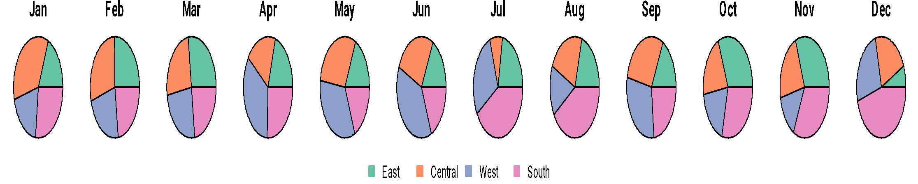
Solution 1: Sequence of pie charts
Pie charts are one way in which we can represent part-to-whole relationships …
We can use a sequence of them to represent the evolution of sales over time.
What is wrong with this visualization?

Slide 7
Solution 1: Sequence of pie charts
Total sales are not represented at all!
Pie charts are a poor way to visualize part-to-whole relationships.
No absolute values!
Comparisons within a month are much easier than comparisons across months …

Slide 8
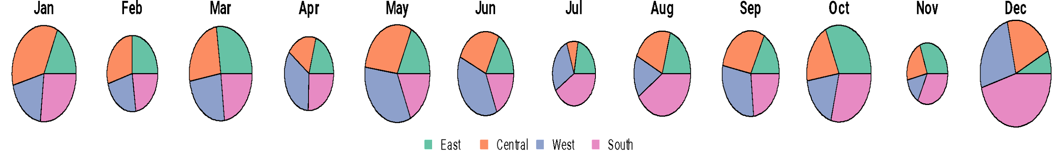
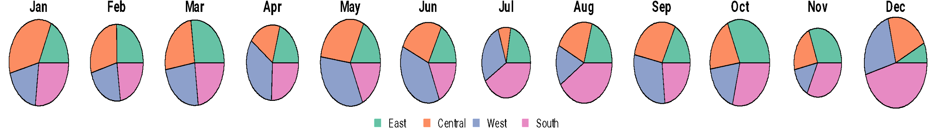
Solution 2: Sequence of pie charts with total sales
To slightly improve on the visualization, you could use the size of the pie to represent total sales …
However, should you use the area or the radius of the pie?
Radius
Area

Slide 9
Solution 2: Sequence of pie charts with total sales
Using the radius emphasizes the differences. This can be useful to convey the big picture, but can also be misleading …
Overall, even this “improved” pie charts do not allow for any accurate comparison!

Slide 10
Solution 3: Stacked bar plots
Previously in the course we have emphasized that bar plots are preferable to pie charts:
The visual cues used by bar plots (length) is higher in the pre-attentive hierarchy than the visual cue used by pie charts (area/angle).
Hence, it would be natural to consider stacked bar plots to represent a time series of part-to-whole data!

Slide 11
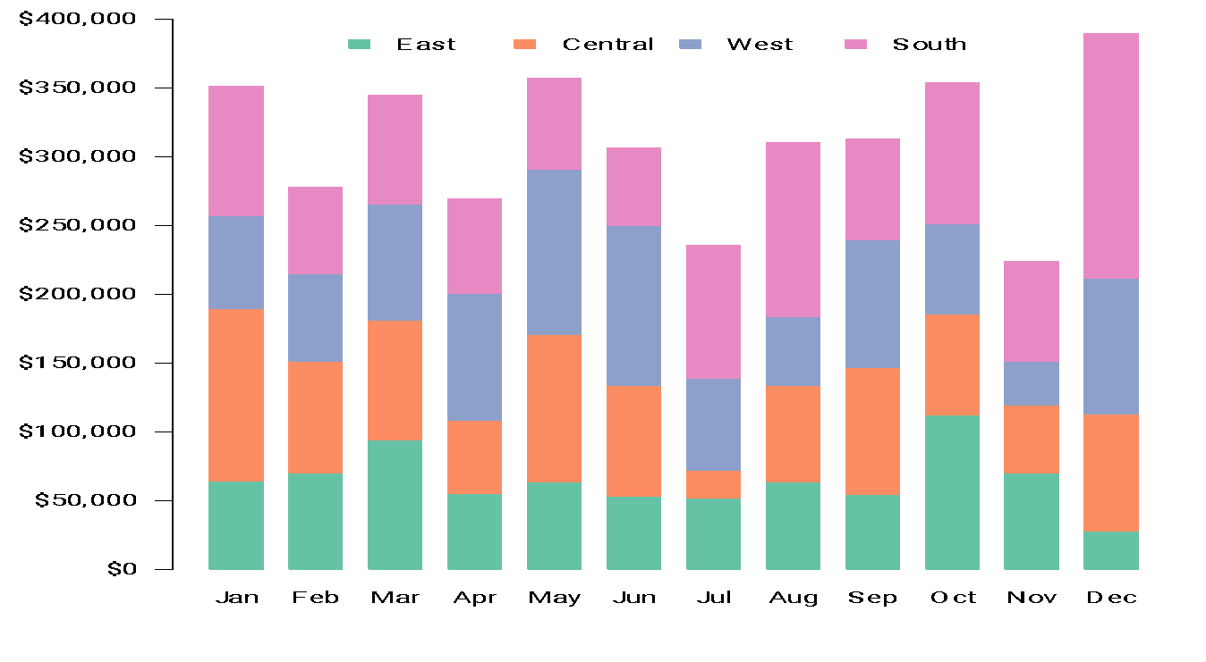
Solution 3: Stacked bar plots

Slide 12
Solution 3: Stacked bar plots
Just as it’s difficult to compare the slices of a pie, it is difficult to compare the segments of a stacked bar.
If the segments were arranged side-by-side and all grew upwards from the same baseline, it would be easy to compare their heights, but when stacked upon one another, the task becomes hard.

Slide 13
Solution 3: Stacked bar plots
As is, the graph is useful for:
Seeing how total sales changed from month to month.
Seeing how sales in the East region changed from month to month (the green segments of the bars at the bottom, which share a common baseline)
It is quite difficult to see how sales in the other regions have changed:
Difficult, but still a bit easier to do this using stacked bars rather than pie charts

Slide 14
Solution 4: Stacked bar plots with lines
Since lines are much better than bars to show changes over time, you might be tempted to add lines to the bar plot.
Since the lines are used as a visual aid, we use a light grey color for them.

Slide 15
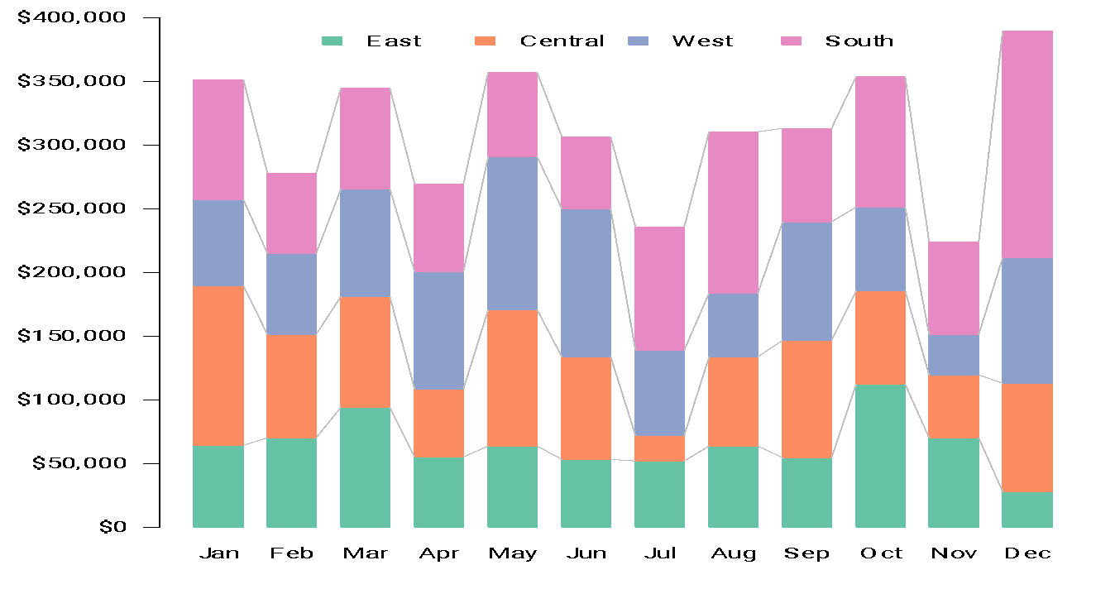
Solution 4: Stacked bar plots with lines

Slide 16
Solution 4: Stacked bar plots with lines
Even with a clean and simple design, and a light color for the lines, this looks quite cluttered!
Beyond this, note that you cannot use the lines to follow the pattern of change in regional sales, except for the bottom segment
Your mind wants to focus on the slope of the line!
Lines do not share a common baseline!
So focusing on the slope is not correct!
The right focus is on the difference between the vertical distance from the lower to the upper line where they connect to the bar on the left versus where they connect to the bar on the right.

Slide 17
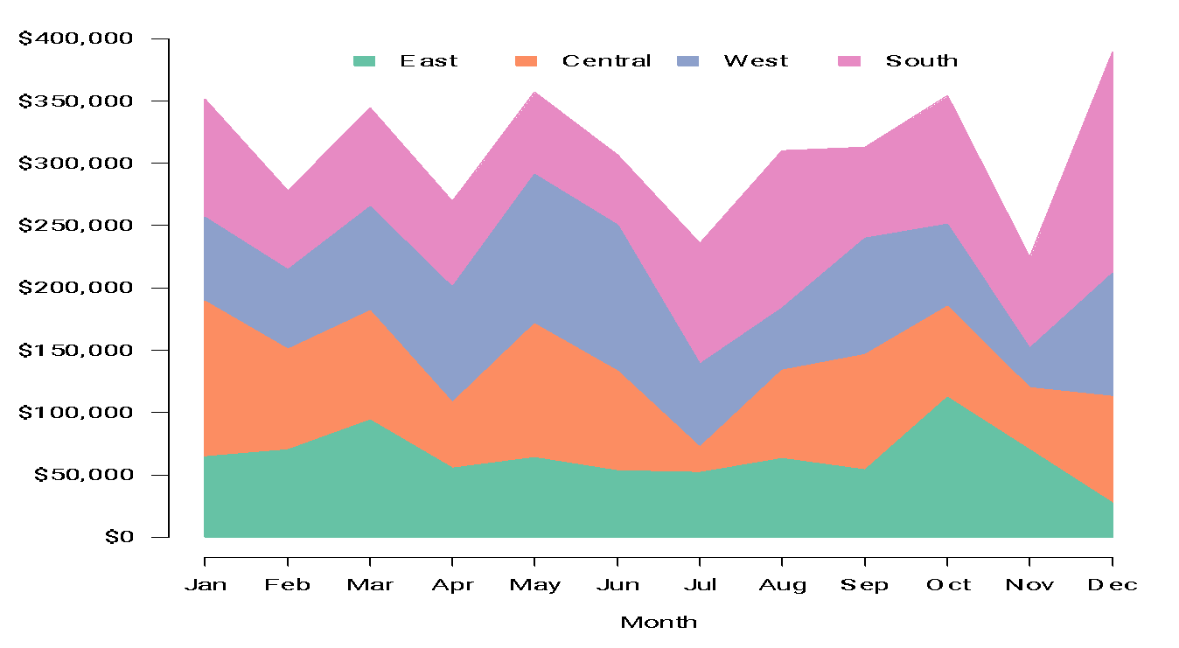
Solution 5: Stacked area plots

Slide 18
Solution 5: Stacked area plots
Stacked area plots are a bit better than stacked bar plots to show time series of part-to-whole data.
However, still suffer from a similar problem:
We can only accurately read the evolution of total sales and sales in the East region.
As before, the slope of the line for other regions depends on the slopes of the lines below it, so you really need to focus on the change in height of the area!!

Slide 19

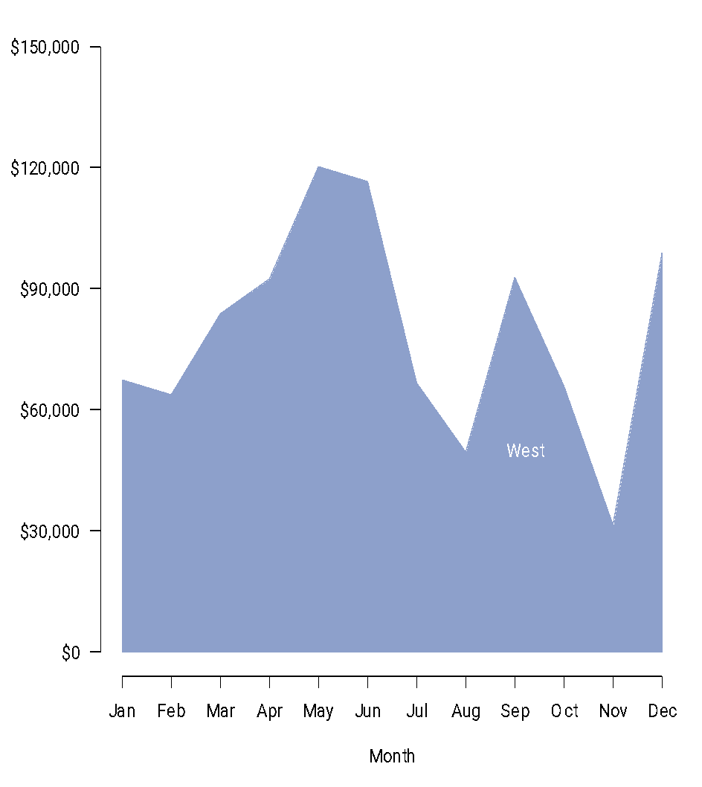
Solution 5: Stacked area plots
If you focus just on the top boundary of the area, you would think that sales went down in April, but that is not the case!!!

Slide 20
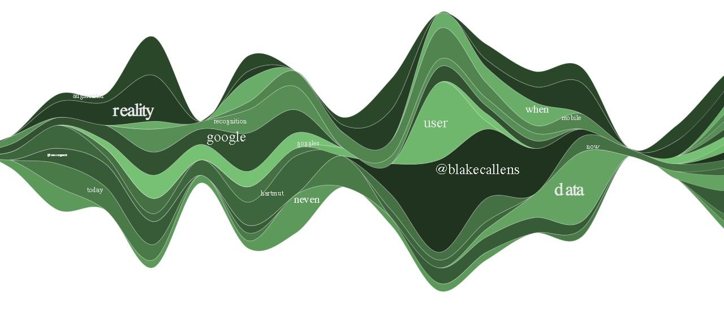
Solution 6: Stream graphs
Steam graphs are a slightly more decorative version of stacked area plots!
The one on the right corresponds to word usage in twitter over time.
Note that, although prettier, the issues are the same!

Slide 21
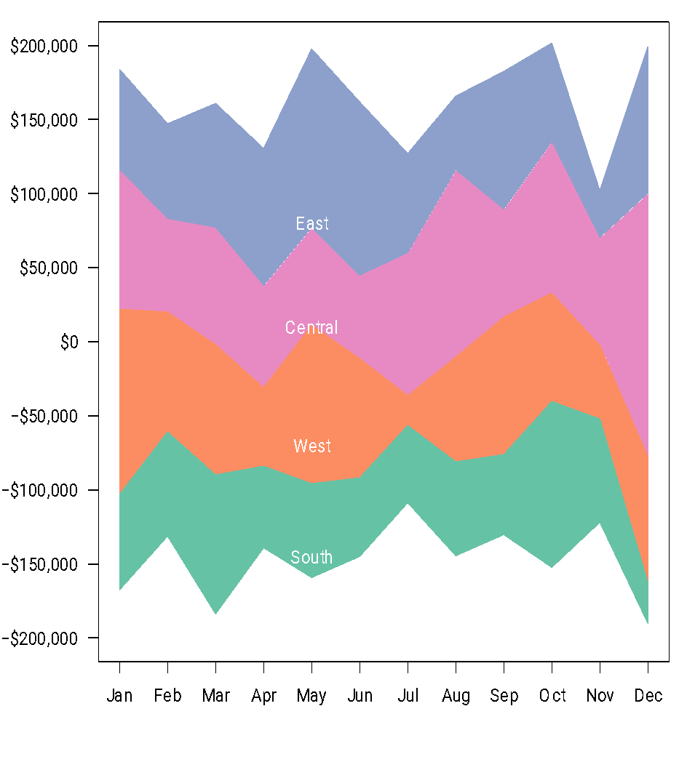
Solution 6: Stream graphs
There is no default function in R to construct stream graphs, but I am providing one in the next slide.
Note that the stream plot is particularly bad in this setting
Negative number suggest losses!!).
We lose the few accurate comparisons we had!

Slide 22
Solution 6: Stream graphs
Because stream plots only let you see the “big picture”, they usually work well only if you have a long time series with many categories and the patterns are “unimodal” or at least “smooth” phenomena that slowly evolves over time!
Not too bad for twitter, movies box office, what people is listening to, etc.
Bad for sales data!

Slide 23
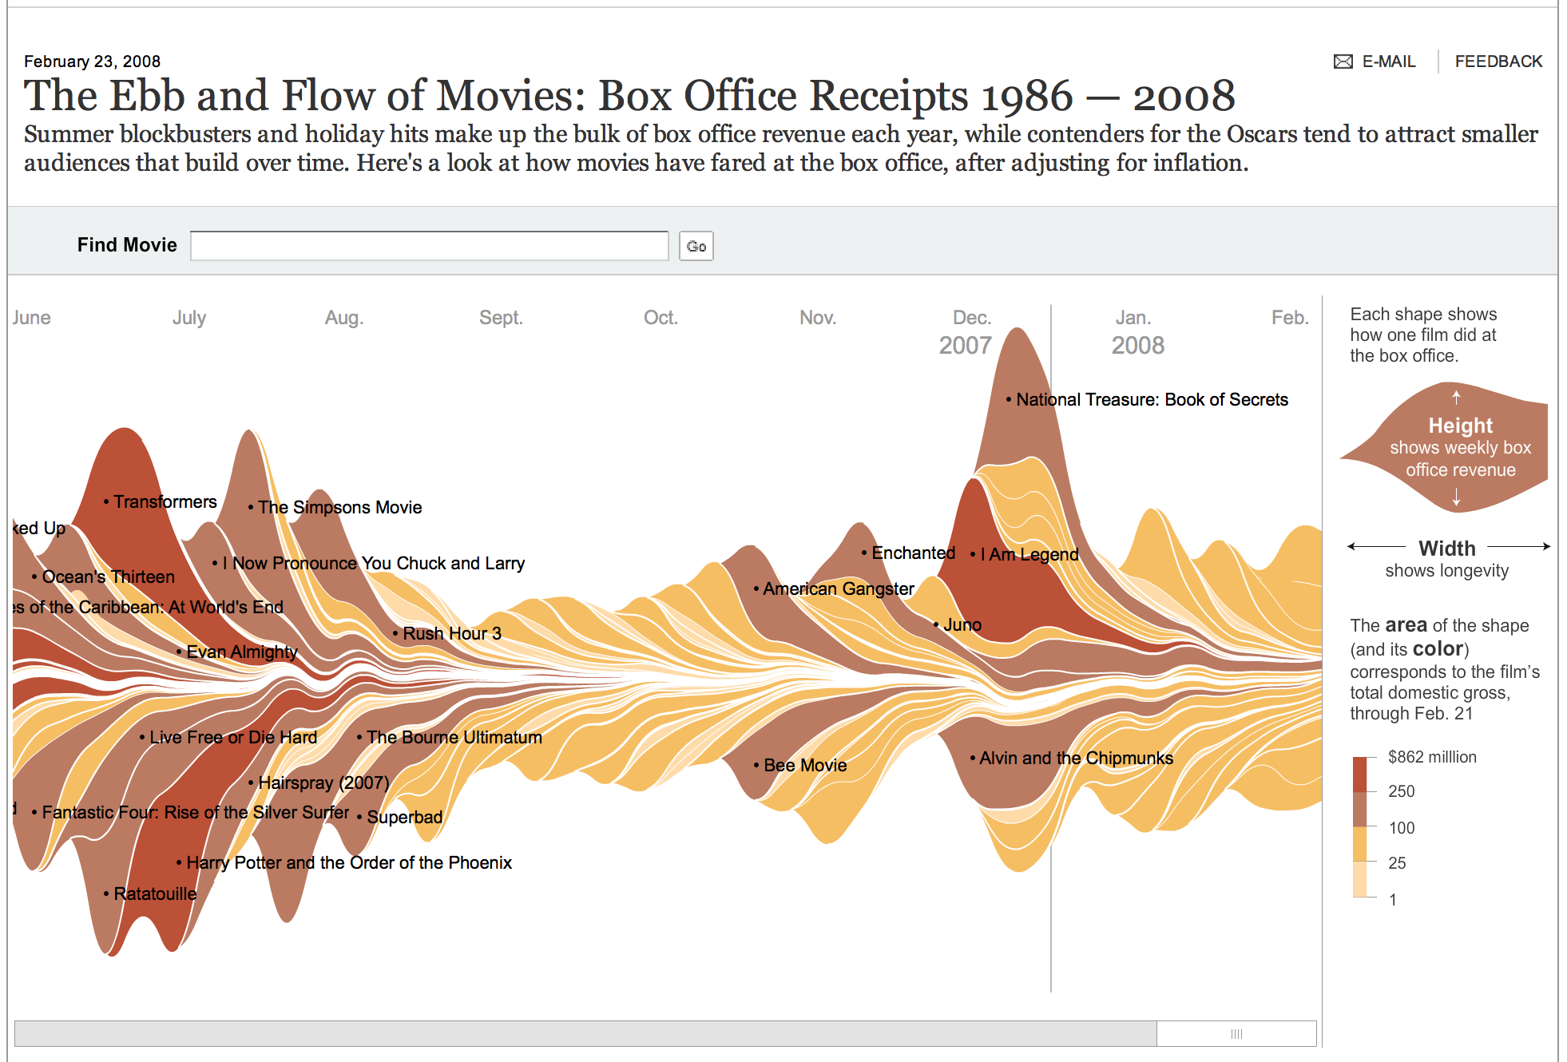
Solution 6: Stream graphs
http://www.nytimes.com/interactive/2008/02/23/movies/20080223_REVENUE_GRAPHIC.html?_r=0

Slide 24
Solution 7: Multiple line graphs
Sometimes trying to pack too much information in a single graph is counterproductive!
Remember that the more multidimensional a graph is, the harder it is to understand.
Rather than creating a single visualization, how about using a group of two (or maybe three) to display the information.

Slide 25
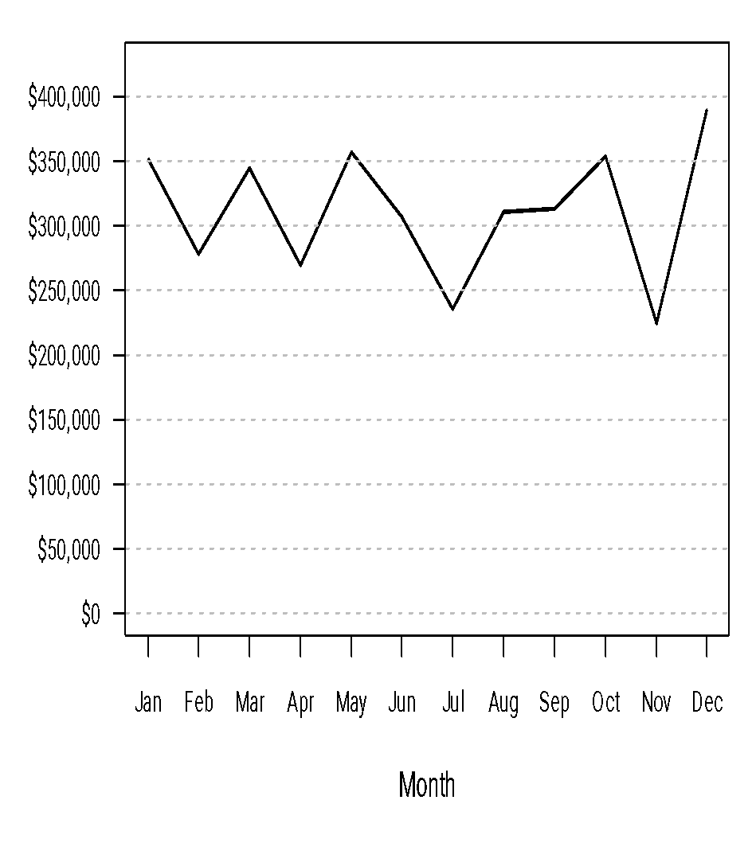
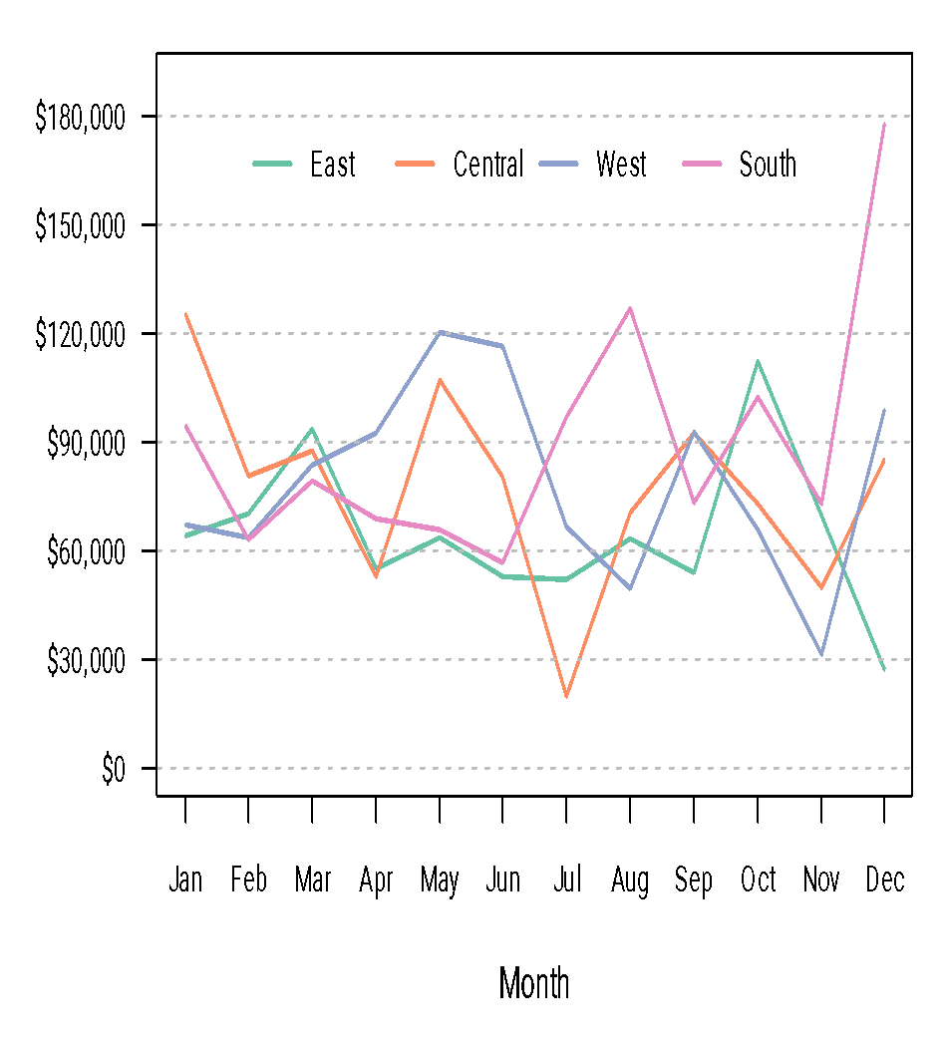
Solution 7: Multiple line graphs
You can clearly see the evolution of sales (both total and on each market), and also how different markets have contributed to to total sales.

Slide 26
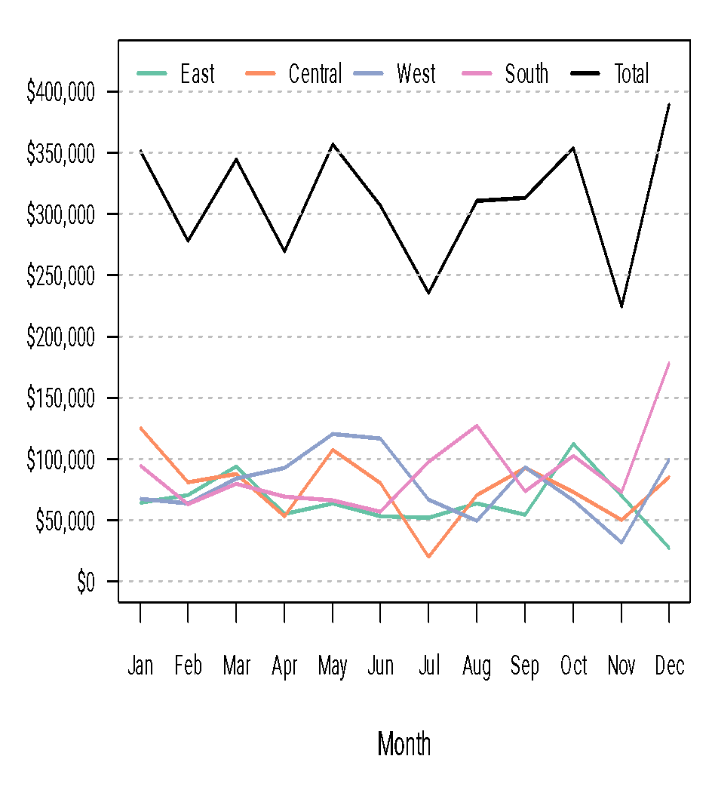
Solution 7: Multiple line graphs
In this case, because there are few parts, it would be possible to generate a single plot that combines total and regional sales.
However, even in this simple case the aspect ratio for the regional sales is a poor one (most slopes are lower than 45°), so comparisons are harder.

Slide 27
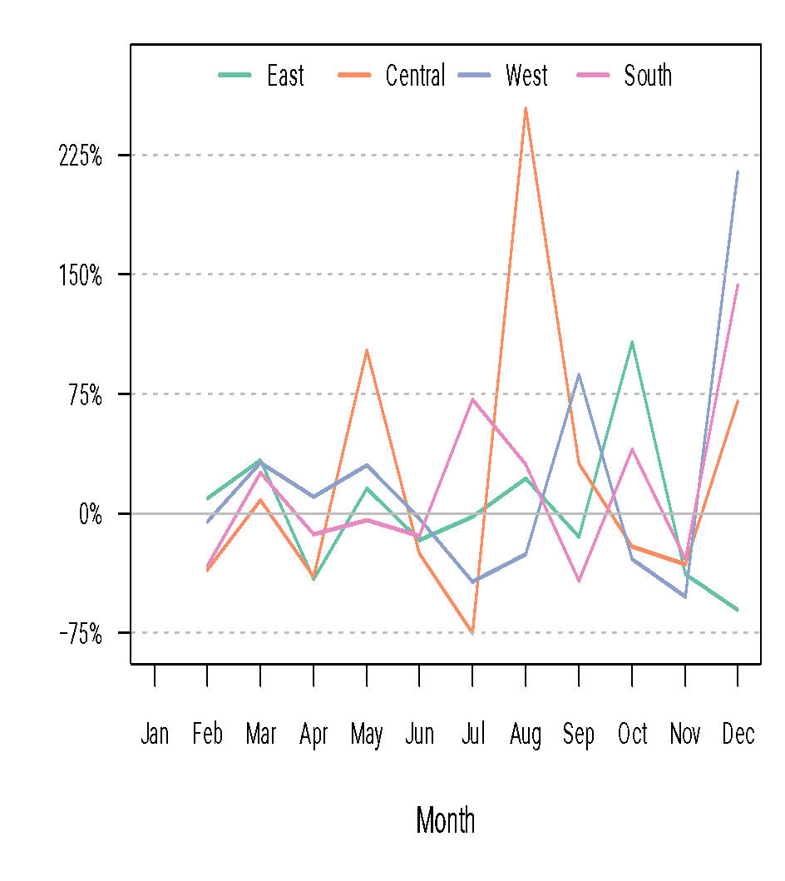
Solution 7: Multiple line graphs
You might want to complement the previous two graphs with one that shows the percent increase over time.
Note that January is the baseline, so we don’t have a percent increase for that month (but we keep it in the graph to simplify comparisons).

Slide 28
Solution 7: Multiple line graphs
Note that I chose an aspect ratio for the plots that makes the slopes close to 45° to make comparisons simpler.
I added grid lines (in grey, and thinner than the sales lines) to allow for more accurate comparisons.
In the percent plot, the grid line at zero is continuous (but still grey and thinner) to highlight that most changes are positive.

Slide 29
PERIODIC DATA

Slide 30
Representing Periodic Data
Often we need to represent data that shows cycles (periodicities):
Weekly patterns (e.g., call volume, restaurant sales).
Monthly patterns (e.g., ATM transactions)
Annual patterns (e.g., temperature, precipitation).
In some of this cases we might not know if such a pattern is present and we would like to better understand it.

Slide 31
Representing Periodic Data
As an example, consider the average monthly temperatures in Santa Cruz county between 1900 and 2014.
Some questions of interest:
What is the warmest month of the year?
What is the coldest month of the year?
Has Santa Cruz gotten warmer over the last 100 years? Has it grown colder?

Slide 32
An Example: Average Monthly Temperatures in Santa Cruz
This is a small piece of the dataset
Year | 1900 | 1901 | 1902 | 1903 | 1904 | 1905 | 1906 | 1907 | 1908 | 1909 | 1910 | 1911 | 1912
Jan | 52.9 | 49 | 46.8 | 49.4 | 47.7 | 50.6 | 50.1 | 48.6 | 51.6 | 51.9 | 46.4 | 49.4 | 51.6
Feb | 52.4 | 52 | 50.1 | 45.9 | 50.5 | 52.9 | 54 | 55.9 | 50.5 | 49.6 | NA | 47.4 | 52.6
Mar | 55.8 | 54 | 50.1 | 51.1 | 52 | 55.8 | 53.2 | 52.1 | 52.5 | 50.6 | 53.9 | 53.3 | 50.6
Apr | 53.9 | 51.7 | 54.1 | 53.6 | 55.3 | 55.7 | 56.9 | 57.7 | 56.1 | 55.9 | 57.3 | 54.5 | 52.4
May | 59.5 | 55.9 | 56.8 | 56.5 | 56.9 | 55.7 | 57.3 | 58.4 | 55.2 | 55.3 | 59.7 | 55.2 | 58.1
Jun | 62.1 | 58.8 | 59.9 | 61.9 | 60.5 | 58.7 | 61.6 | 60.6 | 57.9 | 58.8 | 58.2 | 58.6 | 62.9
Jul | 60.7 | 60 | 61.6 | 60.1 | 61.4 | 63 | 65.5 | 62.3 | 60.9 | 59.8 | 61 | 61.4 | 62.8
Aug | 62.6 | 61.4 | 62.8 | 62 | 61.8 | 61.9 | 62.6 | 61.8 | 60.5 | 60.5 | 58.8 | 61.8 | 63
Sep | 61 | 59.4 | 62.3 | 60.4 | 63.9 | 61.1 | 63.6 | 60.3 | 60.9 | 61.4 | 60.2 | 59.9 | 64.5
Oct | 58 | 60.6 | 58 | 60.1 | 60 | 58.2 | 61.8 | 59.9 | 57.1 | 59.5 | 59.2 | 58.7 | 56.4
Nov | 55.5 | 55 | 52 | 54.1 | 55.6 | 53.3 | 53.3 | 55 | 54.3 | 53.4 | 52.8 | 52.9 | 54.6
Dec | 50.3 | 49.1 | 49.5 | 50.9 | 49.2 | 48.6 | 51.8 | 51.4 | 47.8 | 48.2 | 51.5 | 48 | 47.9
…

Slide 33
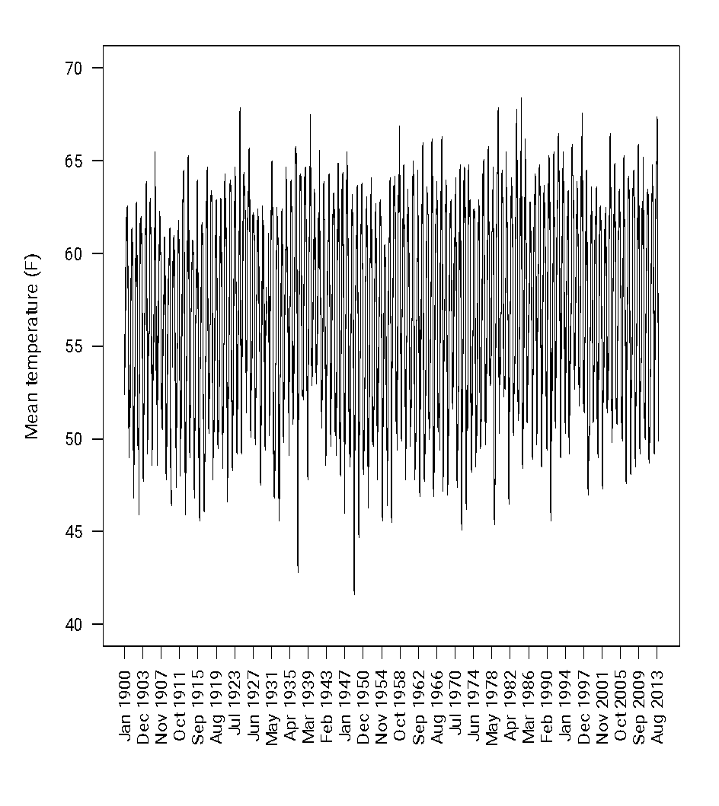
Solution 1: A Line plot
Given that this is a time series, the simplest, solution is to use a line plot.
It conveys two messages well:
Clear periodicity.
Little or no overall trend.
However, a more detailed exploration is hard because it is too cluttered.

Slide 34
Solution 2: Heat maps
Heatmaps can be used to display arrayed-valued data.
We have seen this before, for example, when depicting the evolution over time of the inflation rate in the U.S.
When times series are very long and periodicity very clear, heat maps can be better at conveying the big picture.

Slide 35
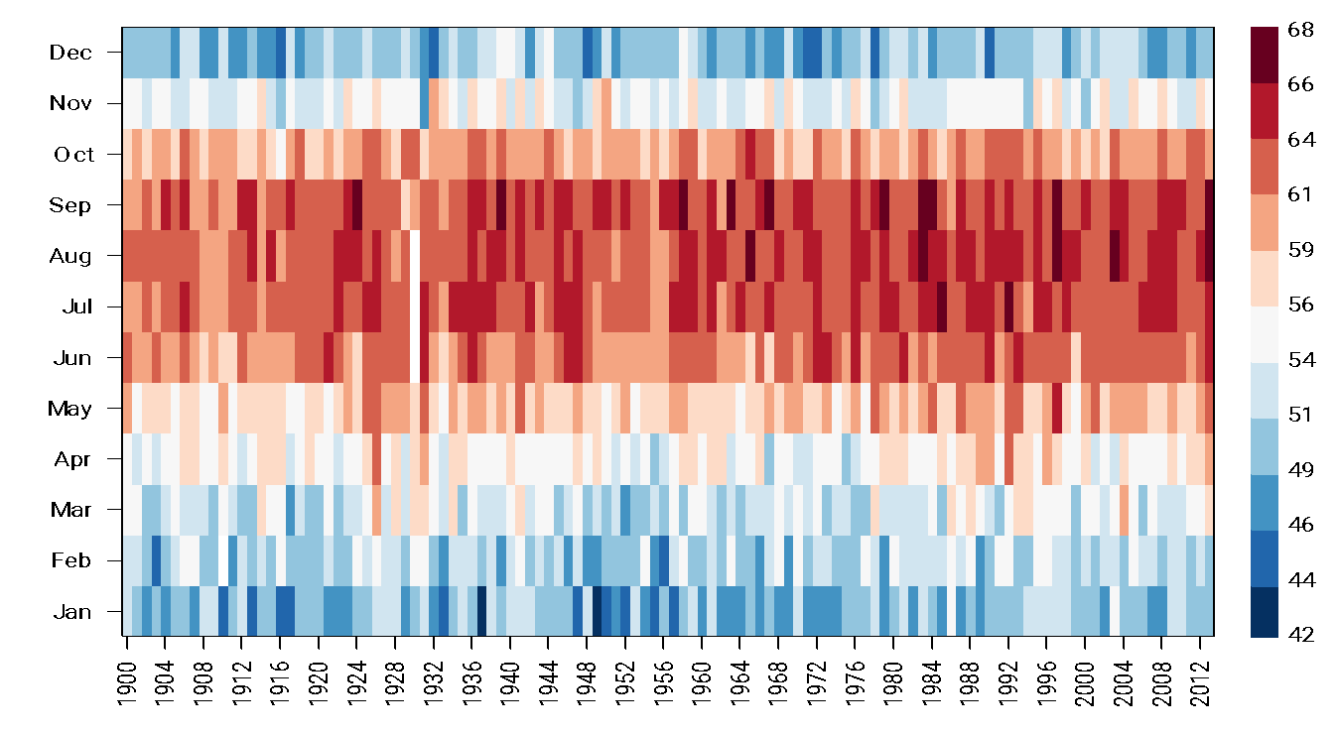
Solution 2: Heat maps

Slide 36
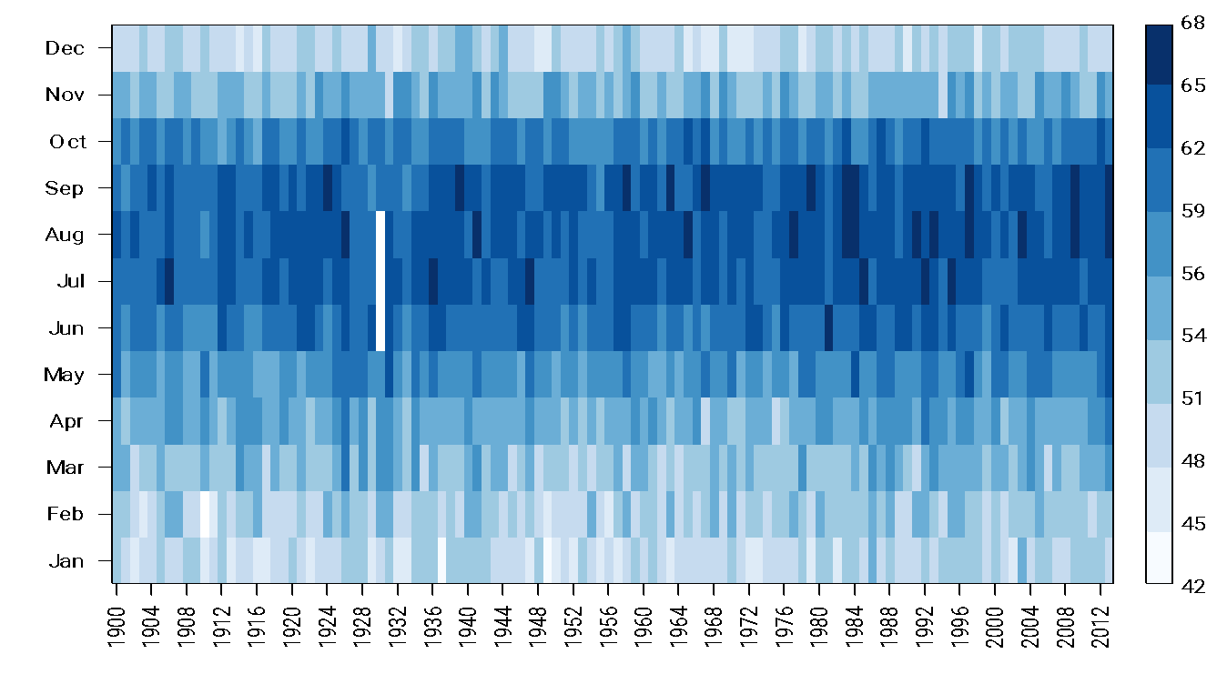
Although you may feel this way …

Slide 37
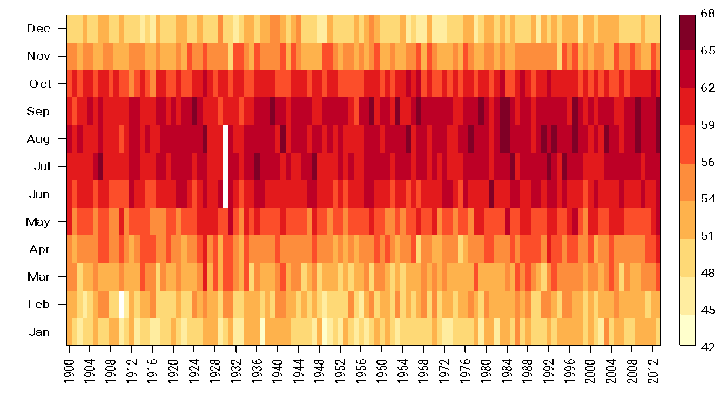
or this way …

Slide 38
Solution 2: Heat maps
Note that I used red for “high” temperatures and blue for “low” temperatures.
Now it is clear from the graph that the warmest months are July, August and September, and the coldest are January and December.
However, heatmaps use colors to represent quantitative variables, and therefore do not allow for very accurate comparisons (recall the hierarchy of visual cues).

Slide 39
Solution 3: Cycle plots
Cycle plots are a variant of line plots invented over 30 years, but rarely used.
In cycle plots, the time series associated with each sub-period (in this example, each month) is plotted together, and context lines for the average temperature on each month are added to facilitate understanding of the periodicities.

Slide 40
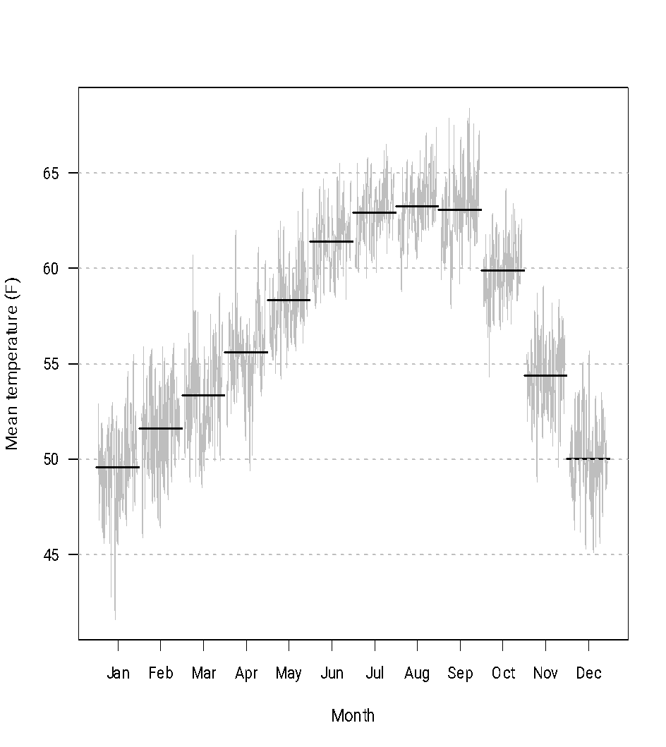
Solution 3: Cycle plots
We could substitute the flat lines with a trend line
From the graph, it is now very clear that August is the warmest month (by a slight margin) and that January is the coldest (also by a slight margin).
Note also that temperatures fall fast, and recover more slowly.
Warmer months seem to show a slight trend, colder months do not.

Slide 41
Solution 4: Polar coordinates plot
A possibly unsatisfactory feature of cycle plots is that January and December appear disconnected, when in reality we expect temperatures to be similar in both months.
A way around this is to use a polar coordinate system to achieve something similar to a cycle plot!

Slide 42
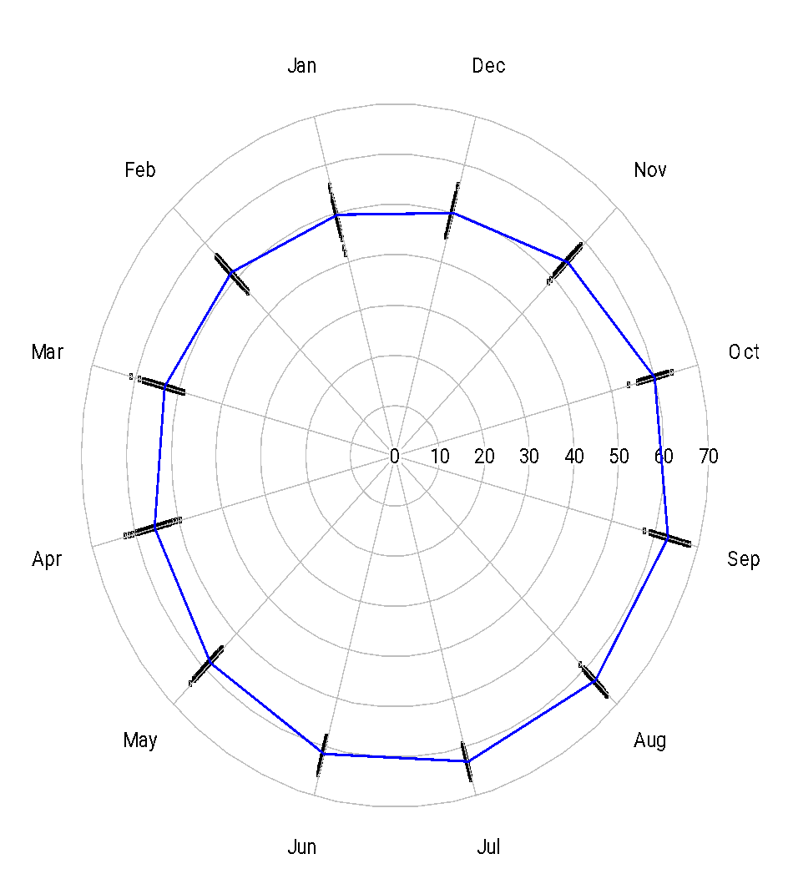
Solution 4: Polar coordinates plot
Again, it is clear that mean temperatures are higher in September, but comparisons with August are a bit harder.
It is apparent now that January has more variability than other months.
We lose the ability to understand trend over multiple years.
Polar coordinate plots make sense here because the data “month” is an ordinal variable with a circular (cyclical) order, rather than linear.

Slide 43
Solution 4: Polar coordinates plot
How could the graph be improved?
We could try to show trends like in the cycle plot.
Additional context information (such as the season) could be added.

Slide 44
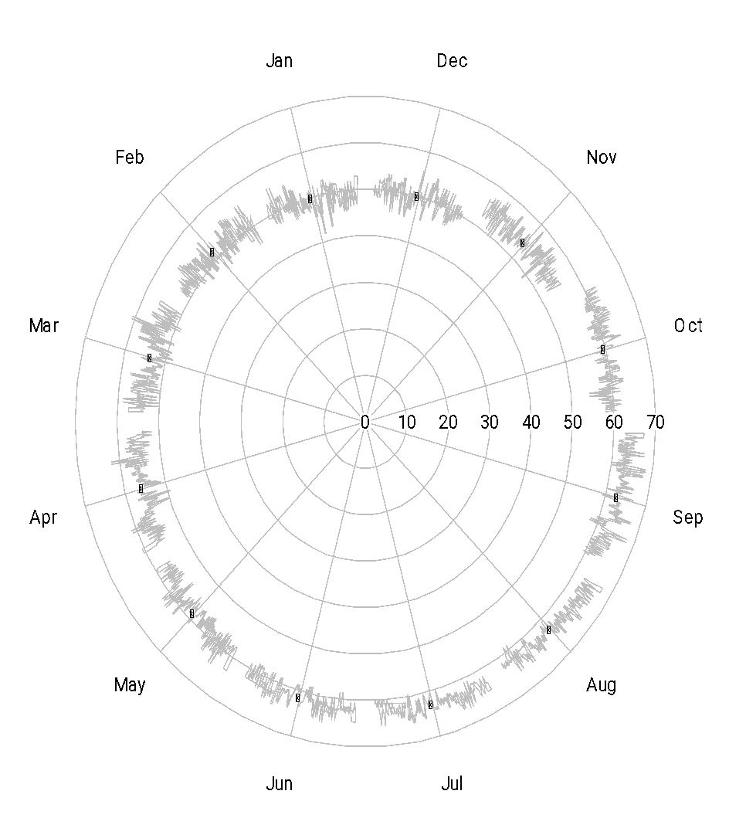
Solution 4: Polar coordinates plot
This version could be regarded as a polar cycle plot.
Because of the curvature of the circle, trends can be a bit hard to read correctly.

Slide 45
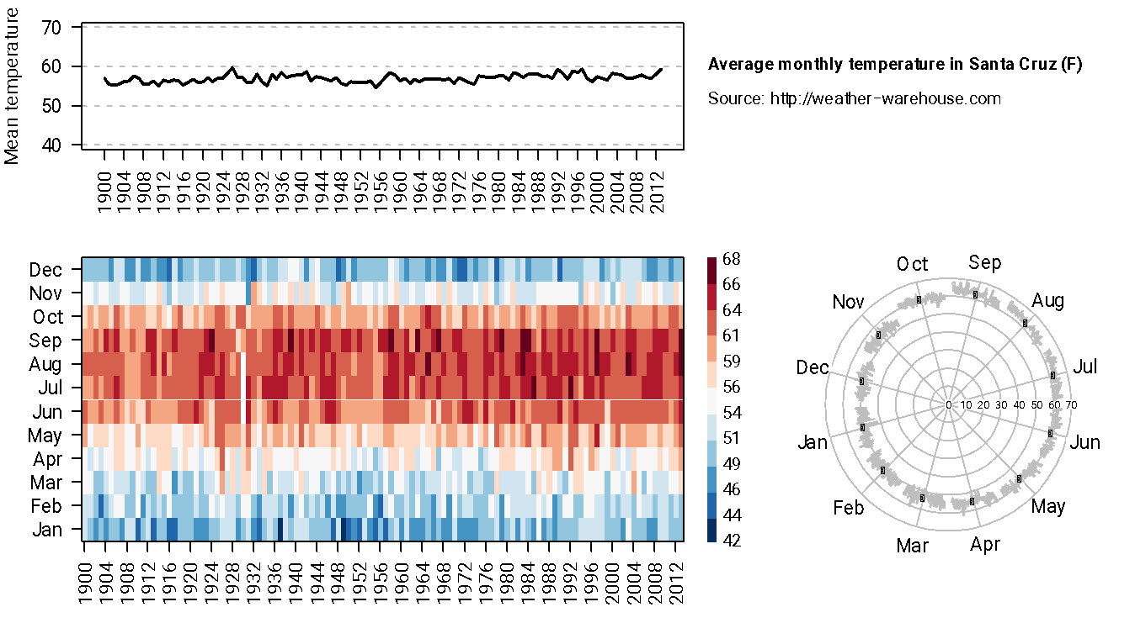
Solution 5: Combined graph

Slide 46
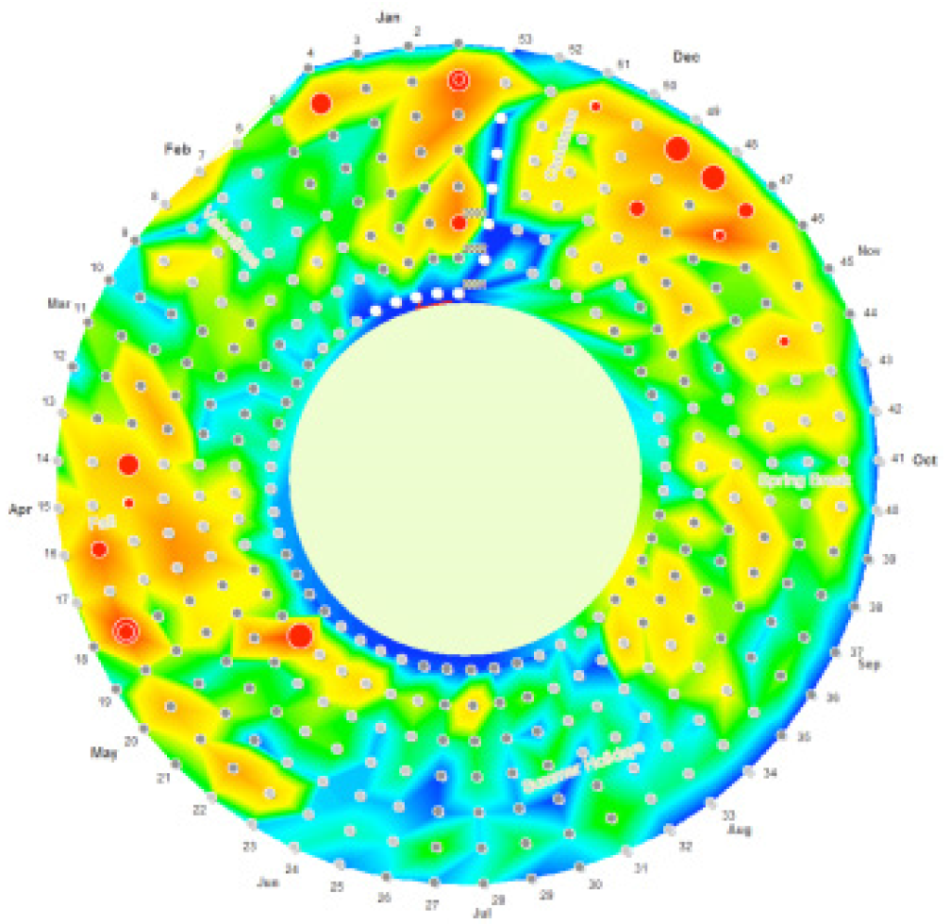
Additional possible solutions
This is more or less a heat map arranged in circular rather than linear form.
Think about a spiral, or wind a cord around a coil or spool.
Area of regions towards the outside is larger than areas towards the center.
Effect of dispersion could be important, not clear it is better than a regular heat map.
This is not the Santa Cruz temperature data

Slide 47
CROSS-CLASSIFIED VS. HIERARCHICALLY-CLASSIFIED DATA

Slide 48
Cross-classified data
We talk about cross-classified data when we can potentially observe the response of interest for any combination of levels of two or more categorical variables.
What is the meaning attached to colors in different cultures?
In a way, similar to time-series of part-to-whole, but sequential nature.
Stacked or side-by-side plots are common solutions in this setting.

Slide 49
Hierarchically-classified data
In hierarchical data, the categories in lower levels are nested in those of the upper levels, so the “meaning” of the category 1 in level 2 depends on which category it belongs to on level 1.
Countries within continents.
Specific diseases within disease type.
Treemaps are the most common solution for hierarchical data.

Slide 50
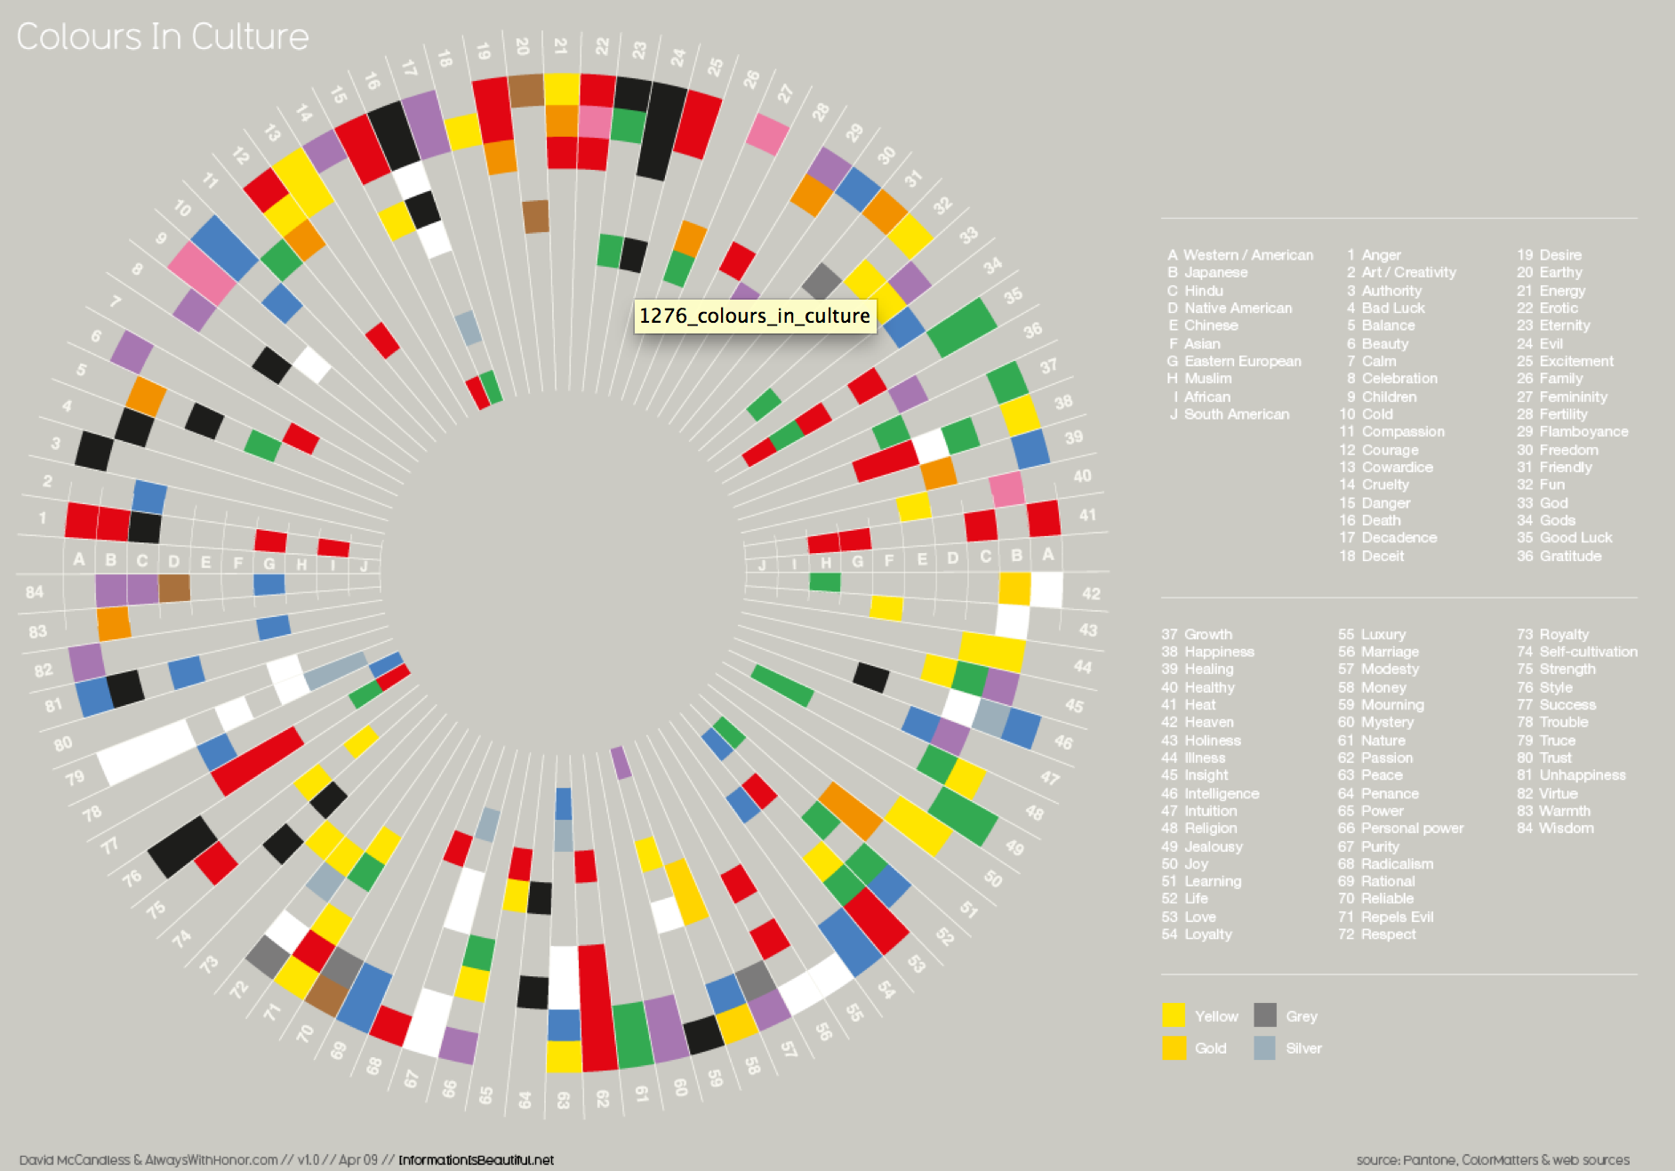
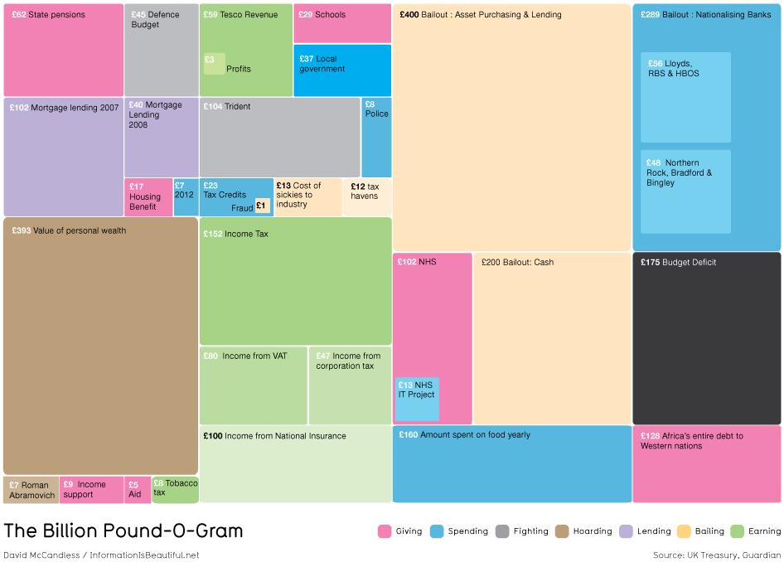
Crossed vs. hierarchical classification
Both graphs taken from David McCandless’ book

Slide 51
Crossed vs. hierarchical classification
Crossed classification
Hierarchical classification
Western
Hindu
Level 1
Asia
Europe
Hate
Sorrow
Hate
Sorrow
Level 2
Japan
China
Spain
France

Slide 52
Example: Colors in culture

Slide 53
Colors in culture
What are the main goals of this visualization?
Lookup.
Highlight similarities across cultures.
Stephen Few notes a number of issues with this visualization.
Hard to read because it is circular.
Having the names of the cultures and feeling on a separate legend makes lookup difficult.
Organization of categories makes comparisons difficult.
He also notes issues with the data itself!

Slide 54
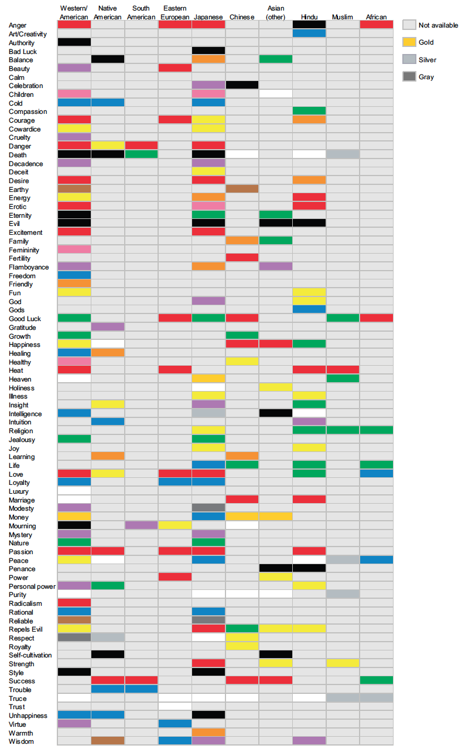
Solution: Heat map
“Linear” arrangement together with labels in graph make it much easier to read!
Rearranging the culture geographically helps in identifying and understanding similarities.

Slide 55
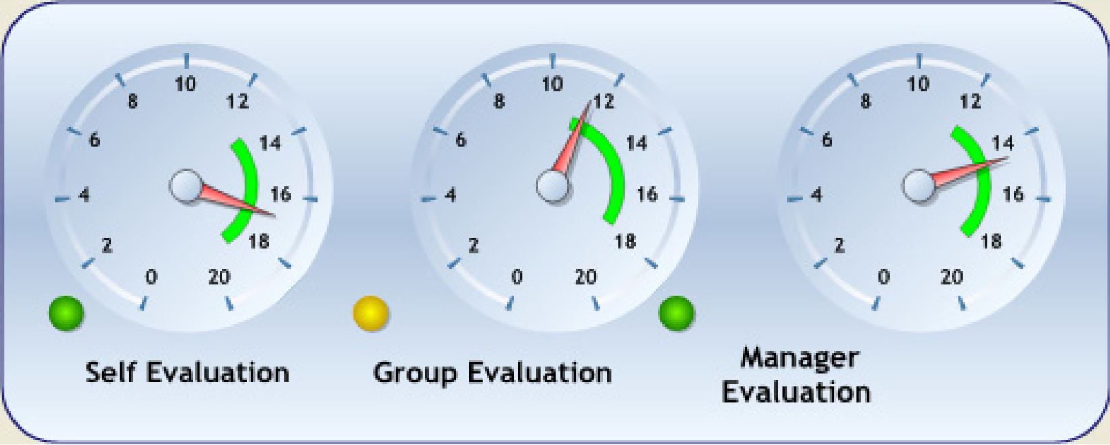
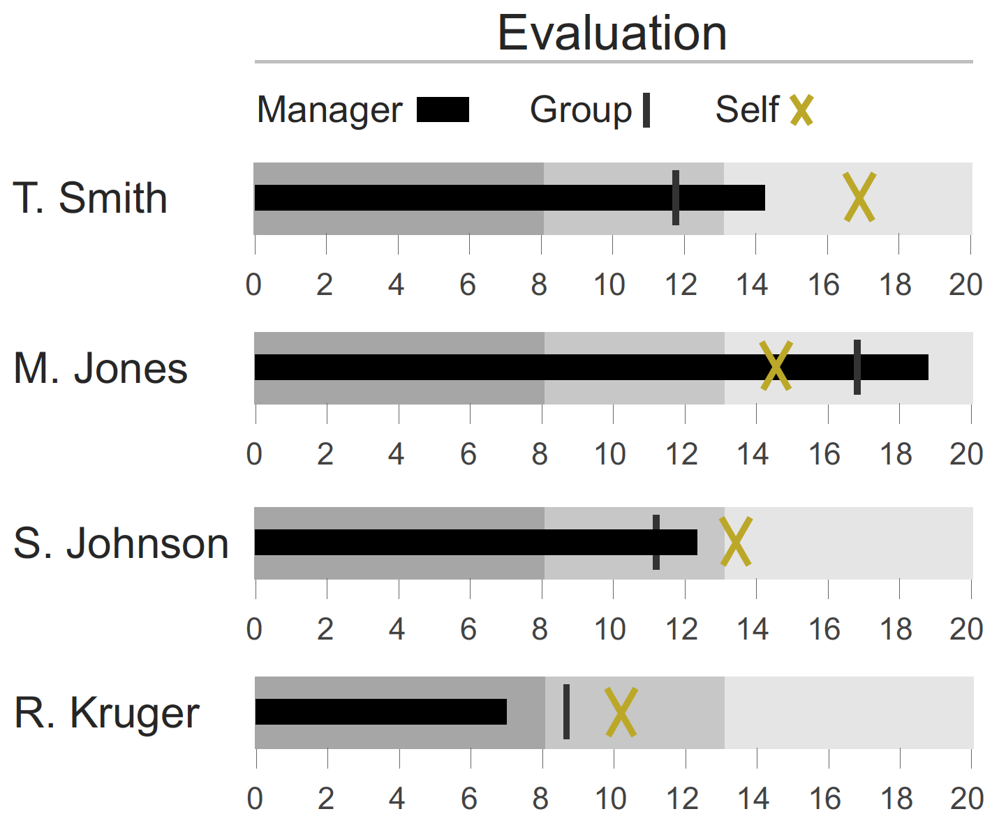
Example: Multiple metrics

Slide 56
Example: Multiple metrics
The decorative design takes too much space and is distracting!
Because they are presented in different circles, comparing self, group and manager evaluations is more difficult (you need to minimize numbers).

Slide 57
The UK’s budget deficit in perspective
The UK’s budget deficit in 2009 was projected to be 175 billion pounds
How much money is that?
How does it compare with the bank bailouts, or other government spending?
How does it compare with the wealth of some of the UK’s richest men?

Slide 58
Solution 1: A tree map

Slide 59
Solution 1: A tree map
Try answering some of these questions (without looking at the actual numbers!):
Which is bigger: Income Support or Police?
Which represents a larger amount: Mortgage Lending 2007 or NHS?
How much greater is Mortgage Lending 2007 than State Pensions?
Does State Pensions compared to Tesco Revenue look like the difference between 62 and 59, or much greater?

Slide 60
Solution 1: A tree map
Because 2D areas are low in the visual hierarchy, exact comparisons are difficult.
Furthermore, there are a number of issues with this particular visualization:
Color lightness changes inconsistently: sometimes it denotes nesting, as in the top right box associated with the nationalization of banks, but it is unknown what it denotes in others (why is Income from National Insurance Lighter?).
He does not group together items that belong to the same category …

Slide 61
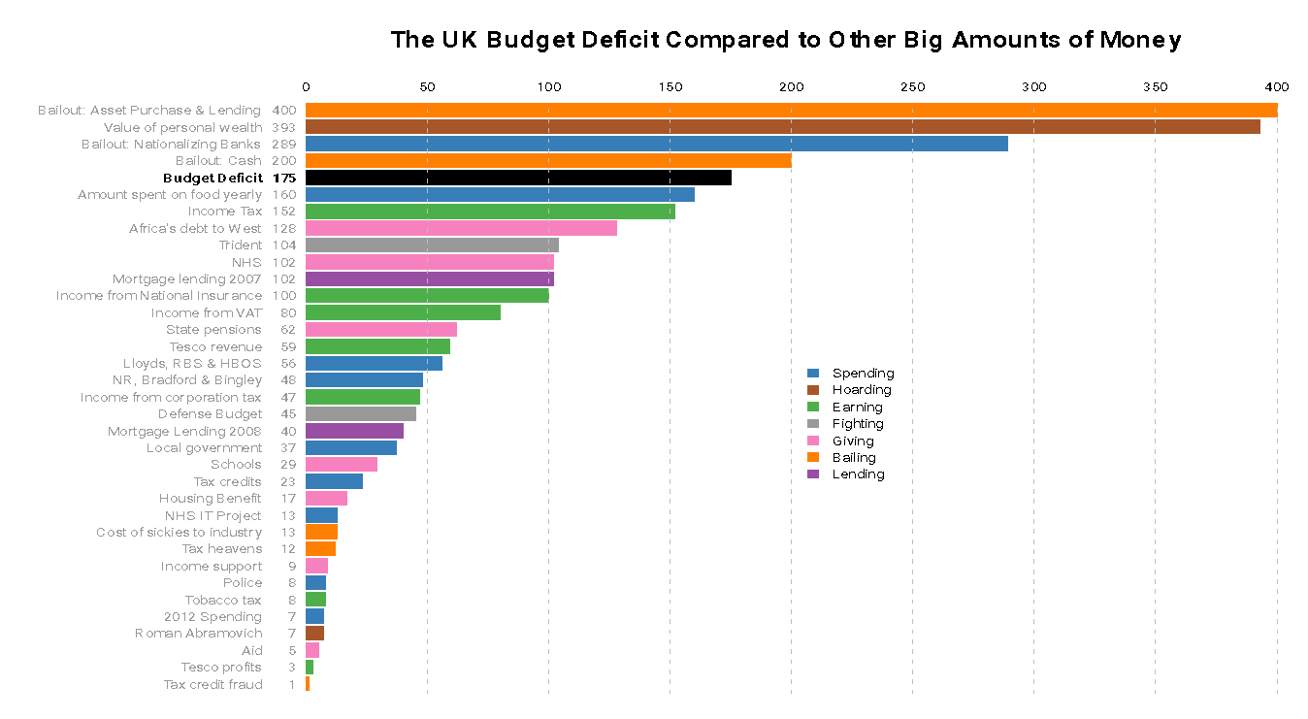
Solution 2: Bar plots

Slide 62
Solution 2: Bar plots
Although McCandless uses his treemap poorly, there are still a couple of advantages to it:
Comparison of nested categories is straightforward (e.g., the bailout by nationalization of banks).
By placing certain boxes close to each other you are implicitly editorializing.

Slide 63
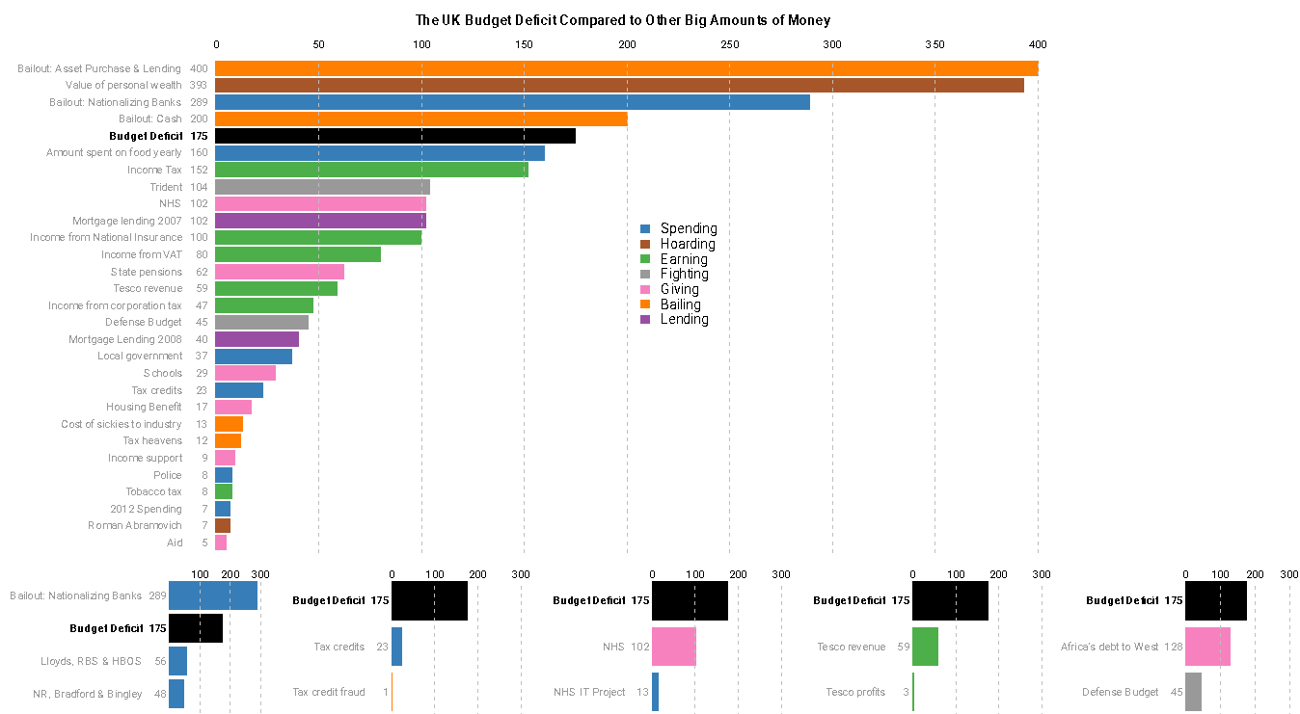
Solution 3: Combination graph
You could add text here where you make your point about the graphs.
The three blue bars could be replaced with a stacked bar plots.

Slide 64
Solution 3: Combination graph
Some bars were removed from the main graph (those corresponding to nested boxes in the original graph), and smaller bar plots added to represent them.
This addresses the two issues discussed before:
If you want to emphasize specific comparisons you can add extra bar plots for them. This is similar to placing boxes near each other.
Nested categories are explicitly represented in a single bar plot.

Slide 65
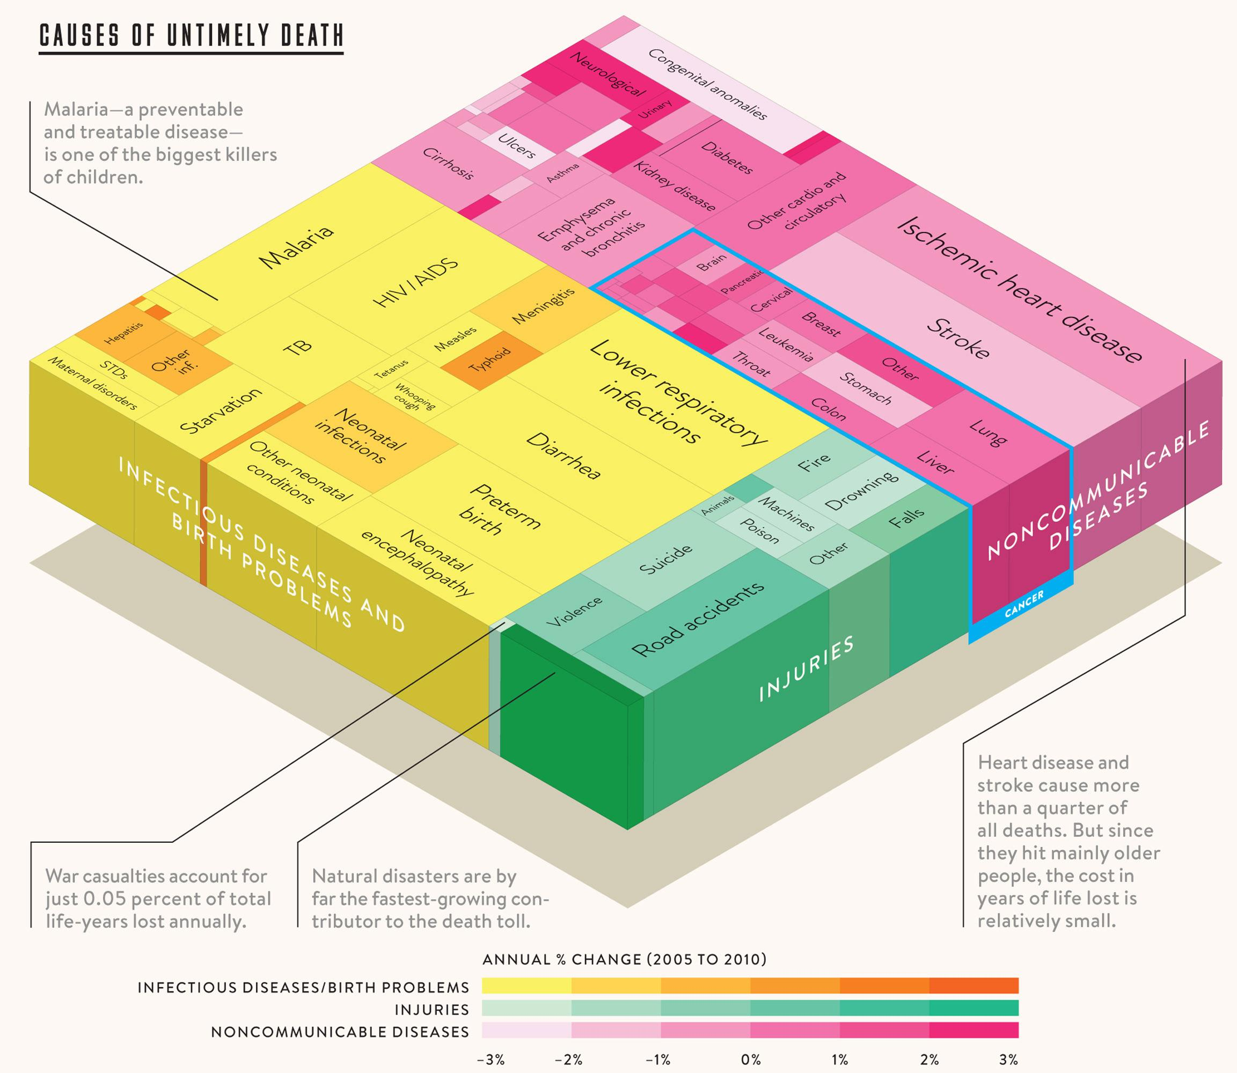
Another example
Can you tell which ones have gone up and which down?
3D is almost always a bad idea
https://www.perceptualedge.com/example20.php
Scale is misleading (should be a divergent scale)

Slide 66
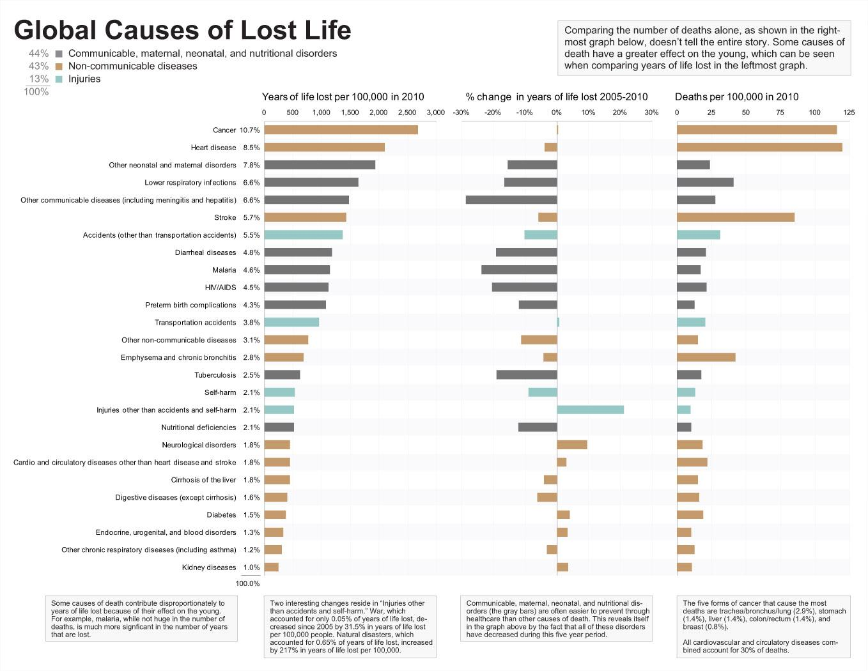
Another example
https://www.perceptualedge.com/example20.php

Slide 67
MOSAIC PLOTS

Slide 68
Mosaic plots
Mosaic plots are used to represent multidimensional part-to-whole relationships.
You can think of them as a generalization of treemaps or pie charts to situations in which you have multiple categorical variables.
Tables for this type of data are often called contingency tables.
http://www.perceptualedge.com/articles/visual_business_intelligence/are_mosaic_plots_worthwhile.pdf

Slide 69
A simple contingency table
Two categorical variables:
Hair color (black, brown, red, blond).
Eye color (brown, blue, hazel, green).
A total of 16 cross-classified groups.
The contingency table contains the number of instances on each cross-classified group.
Eye color | Hair color
 | Black | Brown | Red | Blond | Total
Brown | 10 | 25 | 4 | 2 | 41
Blue | 4 | 18 | 3 | 15 | 40
Hazel | 3 | 13 | 2 | 2 | 20
Green | 1 | 6 | 2 | 3 | 12
Total | 18 | 62 | 11 | 22 | 113

Slide 70
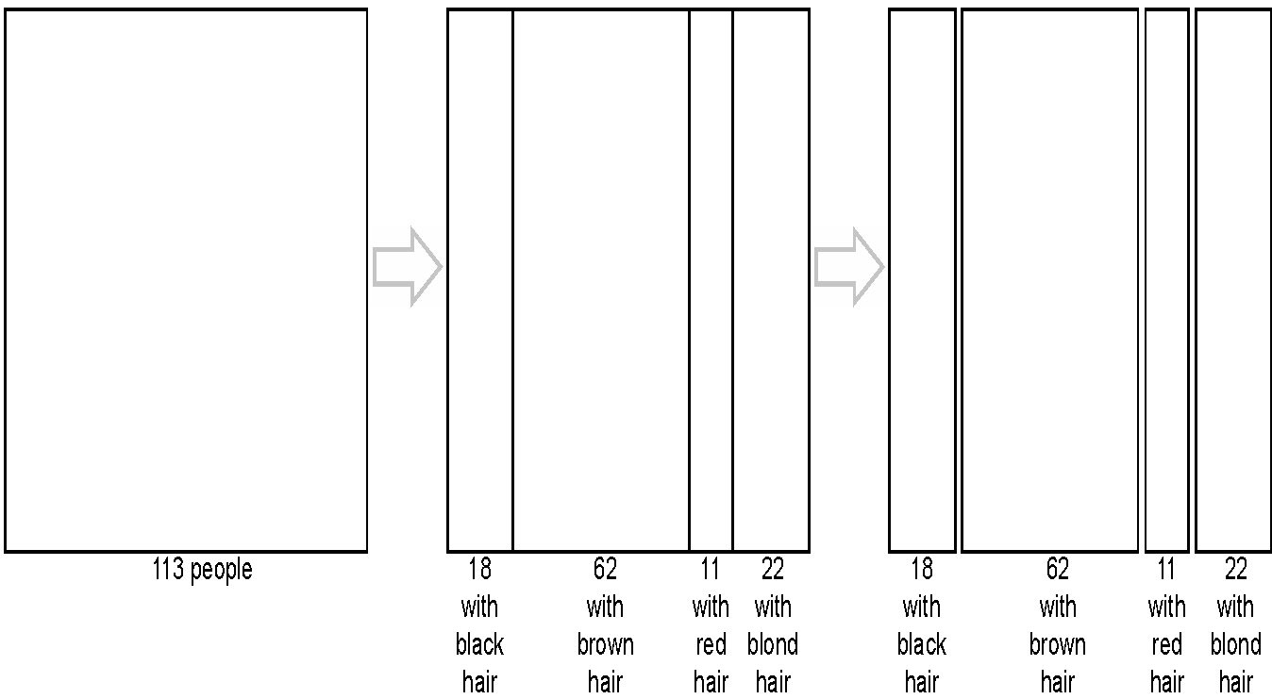
Building a mosaic plot

Slide 71
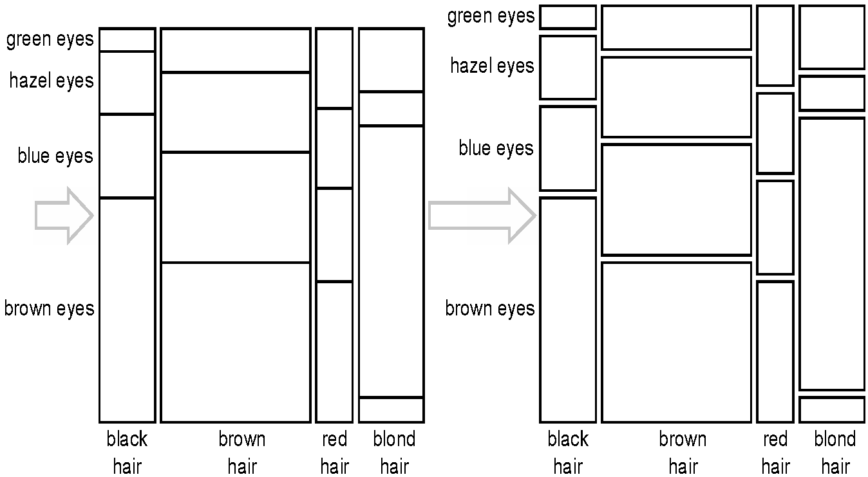
Building a mosaic plot

Slide 72
Building a mosaic plot
Spaces between the sections are conventional, but not necessary. When these spaces are omitted, the graph is sometimes called a Mondrian diagram.
Mosaic plots are not limited to two categorical variables: recursive subdivision in alternative axes.

Slide 73
Issues with mosaic plots
Comparisons of rectangle sizes are complicated by the fact that the rectangles can vary dramatically in aspect ratio.
One variable is encoded as the height of rectangles and the other is encoded as their widths, but it is difficult to focus independently on either heights or widths when they both vary.
It is difficult to compare lengths or heights that are not arranged side by side along a common baseline.
It is often difficult to label categorical items.

Slide 74
Alternative solutions
An alternative, much more powerful solution is to use two (or more) sets of bar plots.
In this case, we use one set of barplots to compare the proportions, and a second one to display the total sizes of the populations.
The main issue with this solution is that it is “asymmetric” and it forces you to focus on one particular conditional distribution.

Slide 75
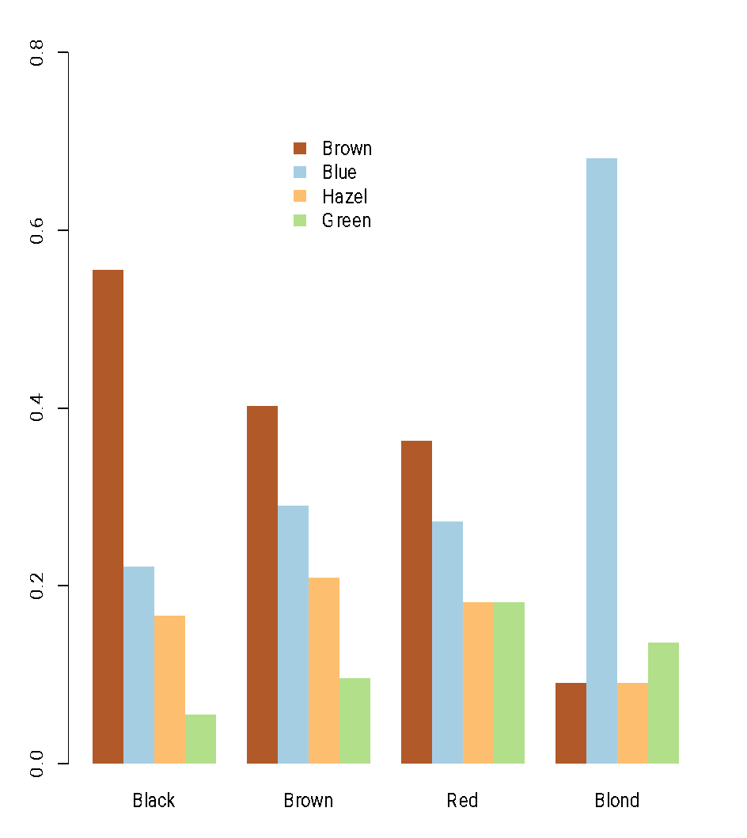
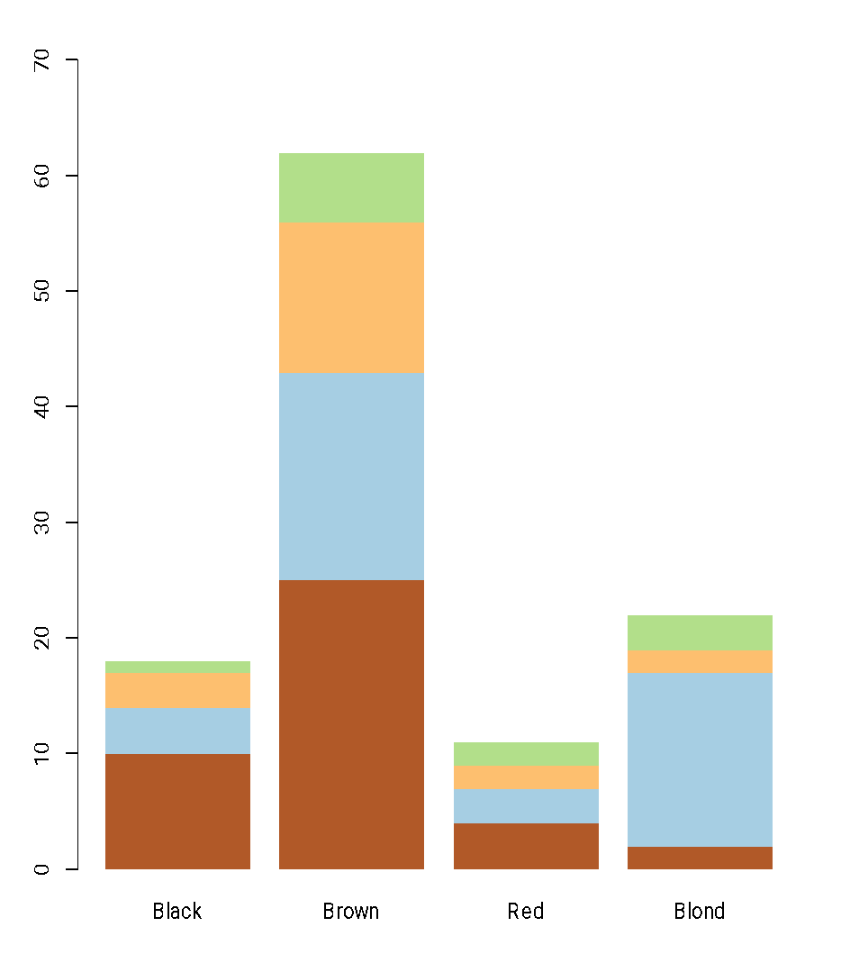
Alternative solutions

Slide 76
Alternative solutions
The graphs could be slightly improved by either placing them one on top of the other or making them horizontal.
It would have been good to also add a graph that shows the total number of subjects with each eye color.
Note the choice of colors for the bars!
Green eyes are the most uncommon.
Blue eyes are fairly uncommon overall, but they are very common if you are blond!

Slide 77
REPRESENTING MANY TIME SERIES

Slide 78
Representing many time series
Line plots are the best solution for representing time series.
Multiple time series are often represented using multiple lines in a single coordinate system.
You need to make sure the units are the same for all series!!
Traditional line plots are most helpful when representing a few long time series simultaneously.
For representing a large number of short time series (2 to 4 time points) a “slopegraph” is a helpful alternative.
For many long time series, a variant called “sparklines” can be used.

Slide 79
Slopegraph
A slopegraph is a variant of line plots that is useful to represent multiple very short time series.
A key feature is the addition of labels identifying the different time series on both the left and right axes.
Slopegraphs are particularly useful to tell a before-and-after story.

Slide 80
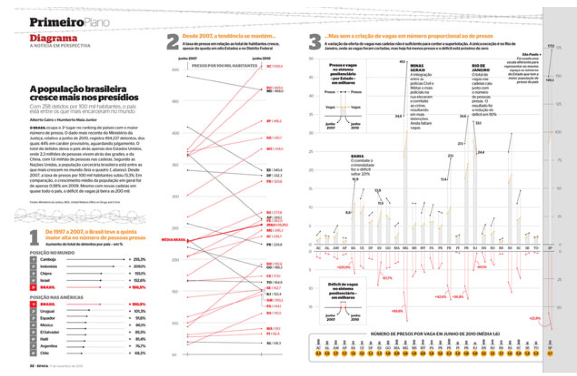
Slopegraph
An example of a slopegraph

Slide 81
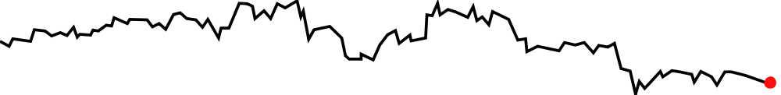
Sparklines
Sparklines are small, high resolution graphics embedded in a context of words, numbers, images. They are sometimes called inline charts.
The Dow Jones index for February 7, 2013.
Sparklines typically do not include any horizontal or vertical axes or coordinates, and are meant to present the general shape of the variation in a simple and highly condensed way.
Multiple sparklines can be stacked together to visualize many time series simultaneously.

Slide 82
Multiple times series with different scales
In many cases we are interested in looking at two (or more) time series simultaneously, which might not be on the same scale.
Running example: Is there a relationship between wealth (GDP) and inequality (Gini index)?
When a country gets richer, does it also get more unequal? Or less?
Data is relatively short: 1979-2008 (only 30 years).

Slide 83
Dealing with times series in different scales
The two variables are in very different scales:
GDP is a positive number (in trillions of dollars).
Gini index is a number between 0 and 1 (larger number means more inequality).
What are the goals of the analysis?
How have the variables changed over time?
What is the association between the two variables?

Slide 84
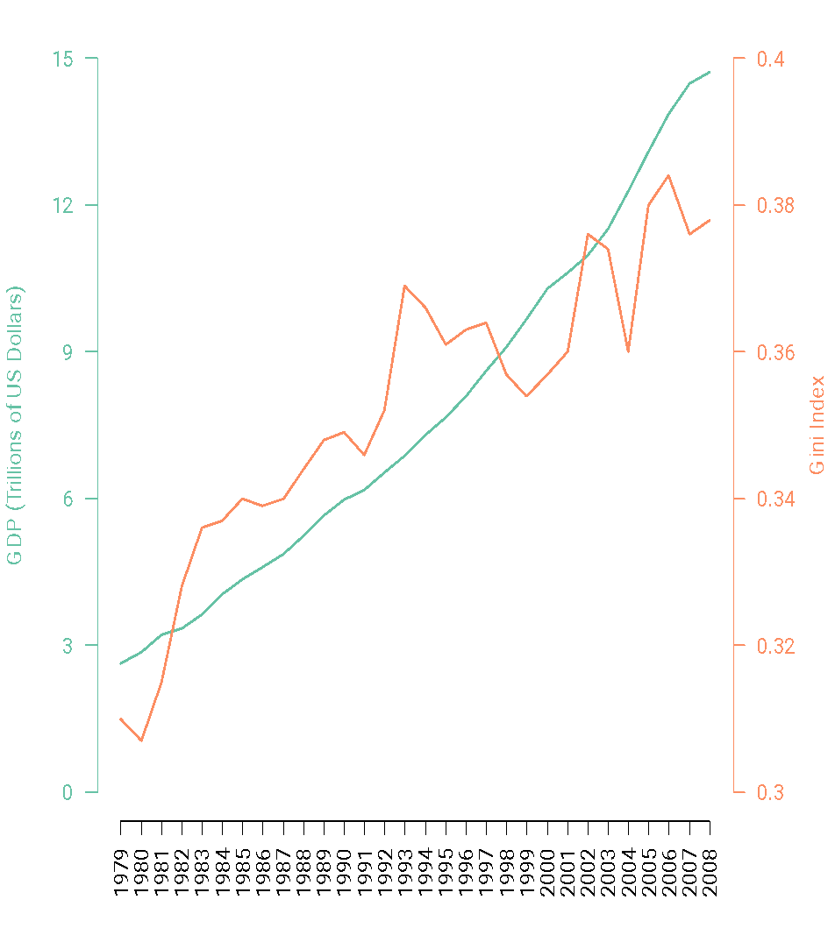
Solution 1: Two scales on a single graph
Both seem to go up with time, but the details of the relationship are not clear.
Some people like to create a single graph with both time series.
Because the two variables have very different scales, you need to have to scales on the y-axis.
Even if you use colors cleverly, this can be extremely confusing.
Generally speaking, you should avoid it!

Slide 85
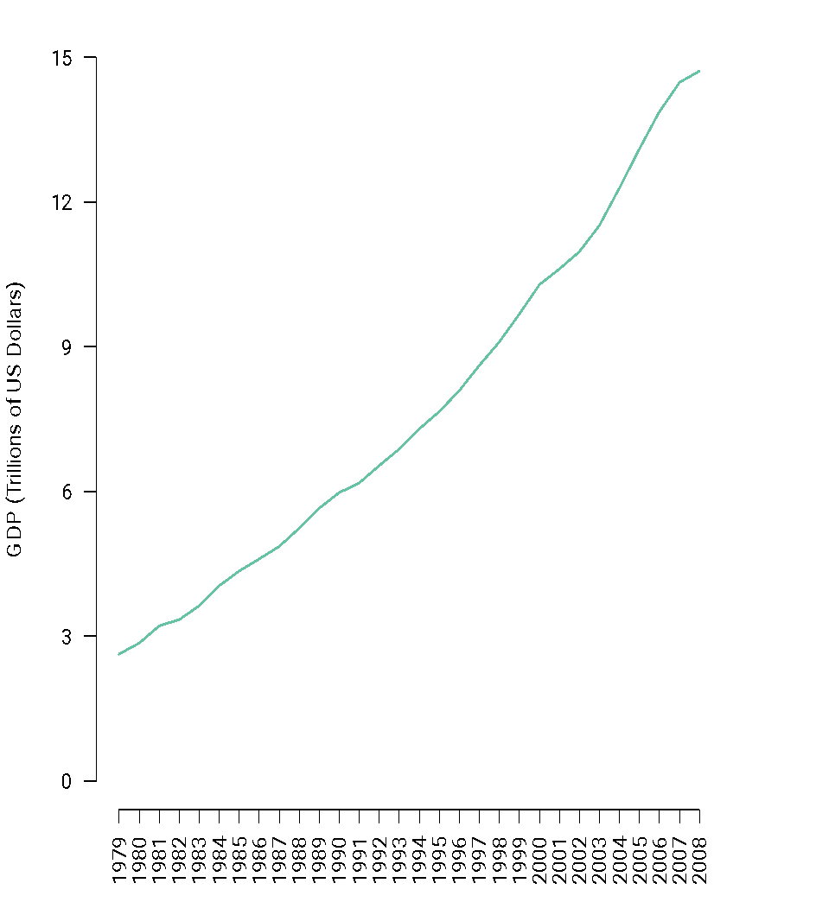
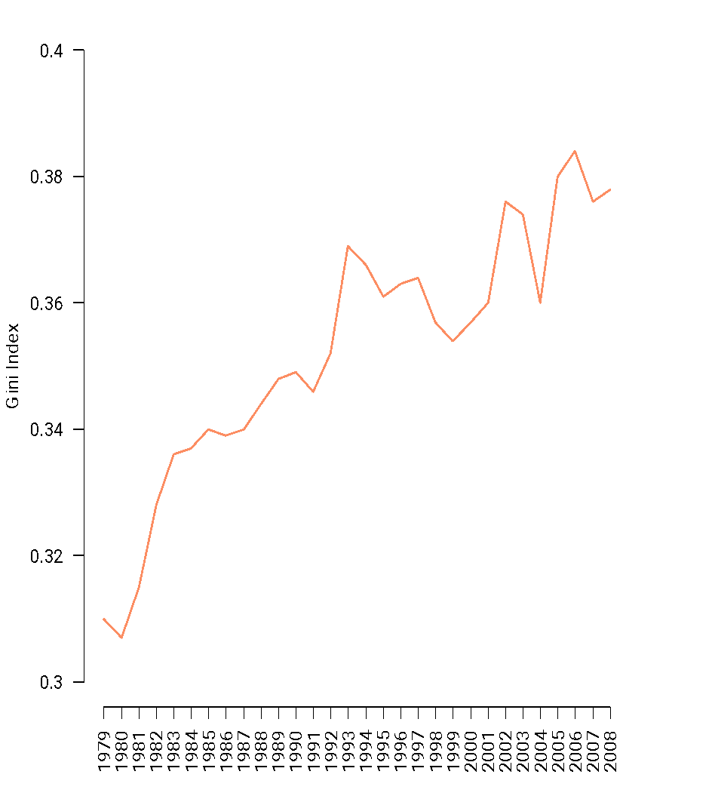
Solution 2: Two line graphs

Slide 86
Solution 2: Two line graphs
This solution is more elegant, avoids confusions about scale, and allows us to observe association across variables as well as placing both graphs in a common coordinate system (particularly if you place one graph above the other).
However, this solution still does not allow us to study correlation in a lot of detail (e.g., is the relationship linear or not?).

Slide 87
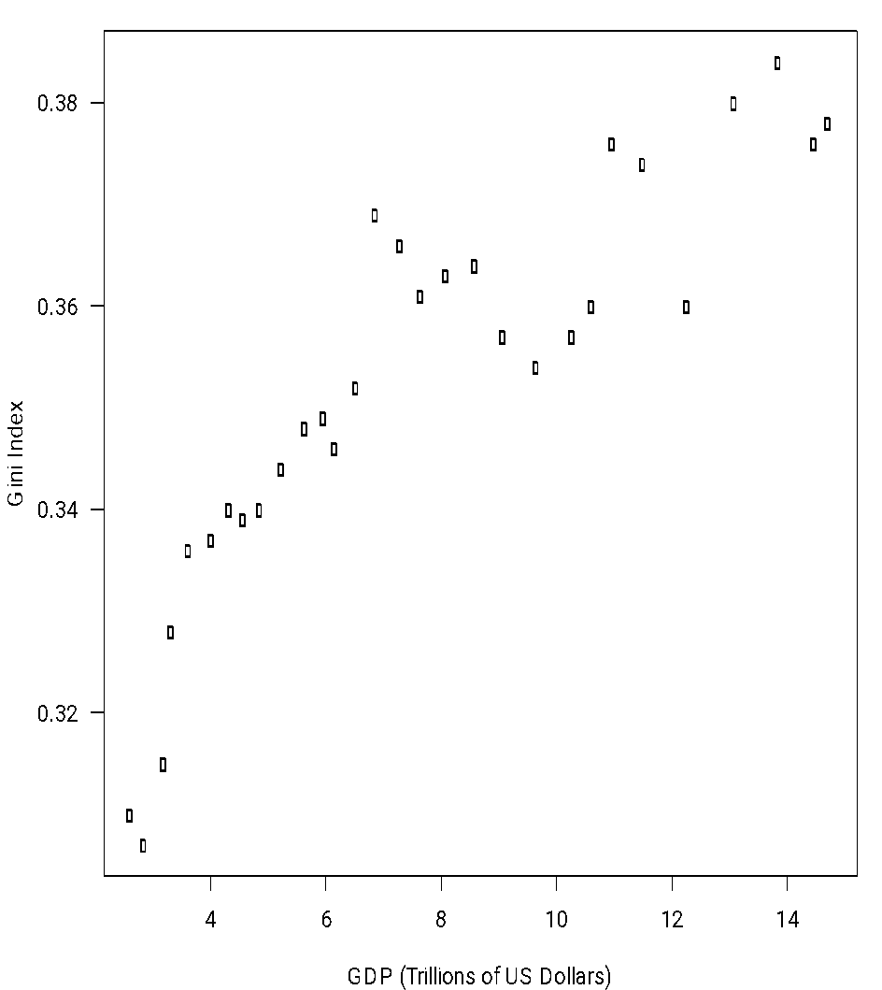
Solution 3: Scatterplot
The natural graph to study correlations among variables is the scatter plot.
It shows that the relationship seems to be more or less linear.
However, information about the evolution over time of the two variables is lost!

Slide 88
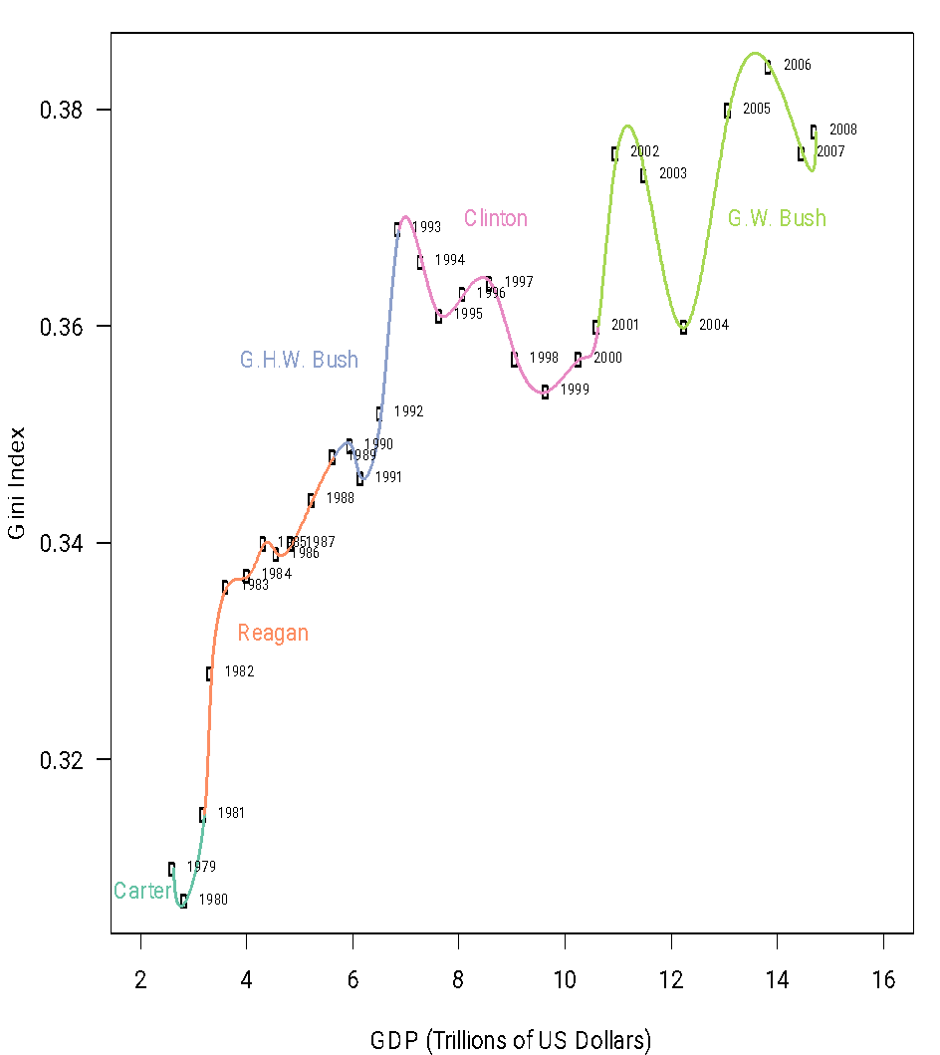
Solution 4: “Interpolated” scatterplot
Values are connected by a smooth line to provide information about the time series.
Curve mostly moves to the left (implying that GDP tended to only grow), while it goes up and down (meaning that the Gini index zigzagged a lot).

Slide 89
Solution 4: “Interpolated” scatterplot
On the design side, note that colors have been added colors to represent different presidencies (as well as the names of the presidents).
The labels of the years have been added too.
A further improvement would add markers for the dates of main economic, political and historical events (Asian financial crises, dot-com bubble burst, tax reform passed, September 11, etc)

Slide 90
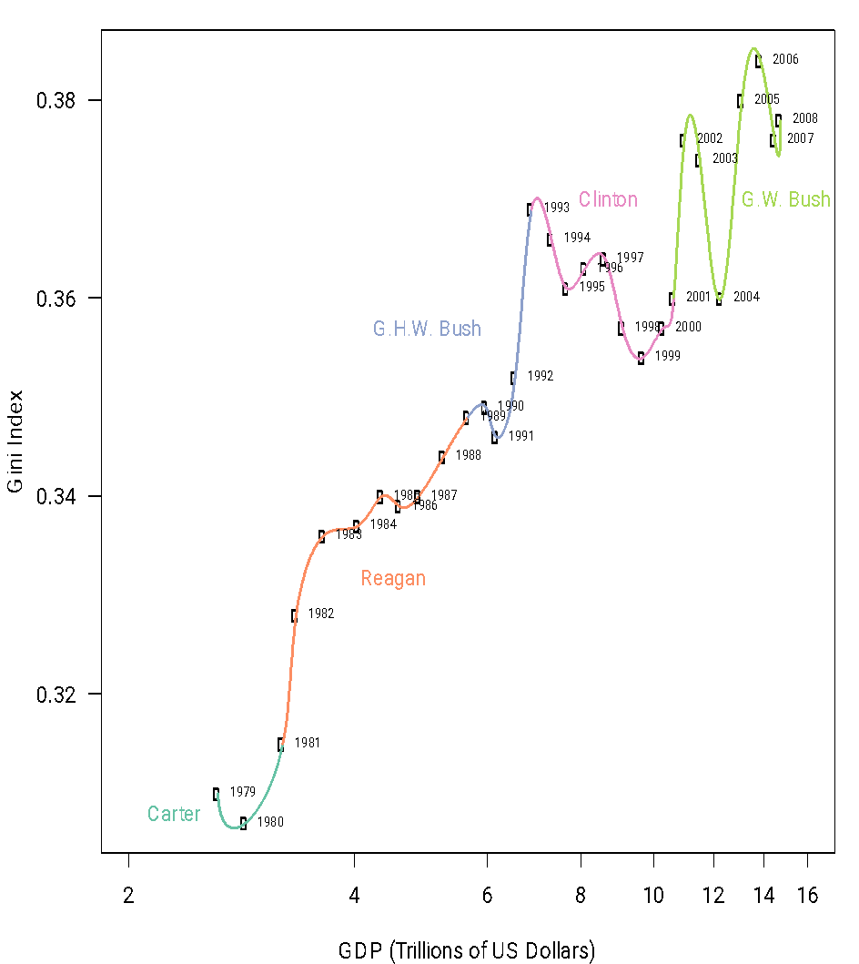
Solution 4: “Interpolated” scatterplot
An improved version could also use a logarithmic scale for GDP (so that comparisons of GDP growth are in relative rather than absolute terms).
It would be useful to have additional data!
Economic expansion was stronger in the Reagan years, and not as strong in the Bush junior years!

Slide 91
Solution 4: “Interpolated” scatterplot
This graph allows you to tell a complex story, both about the individual variables and about their joint evolution over time.
For example, inequality (as measured by the Gini index) has tended to increase over time
Particularly true during the Reagan and Bush senior years.
During Clinton’s presidency it tended to go down (but oscillated a bit).
All over the place for the Bush junior years.
Economic expansion during the Bush senior years was anemic.

Slide 92
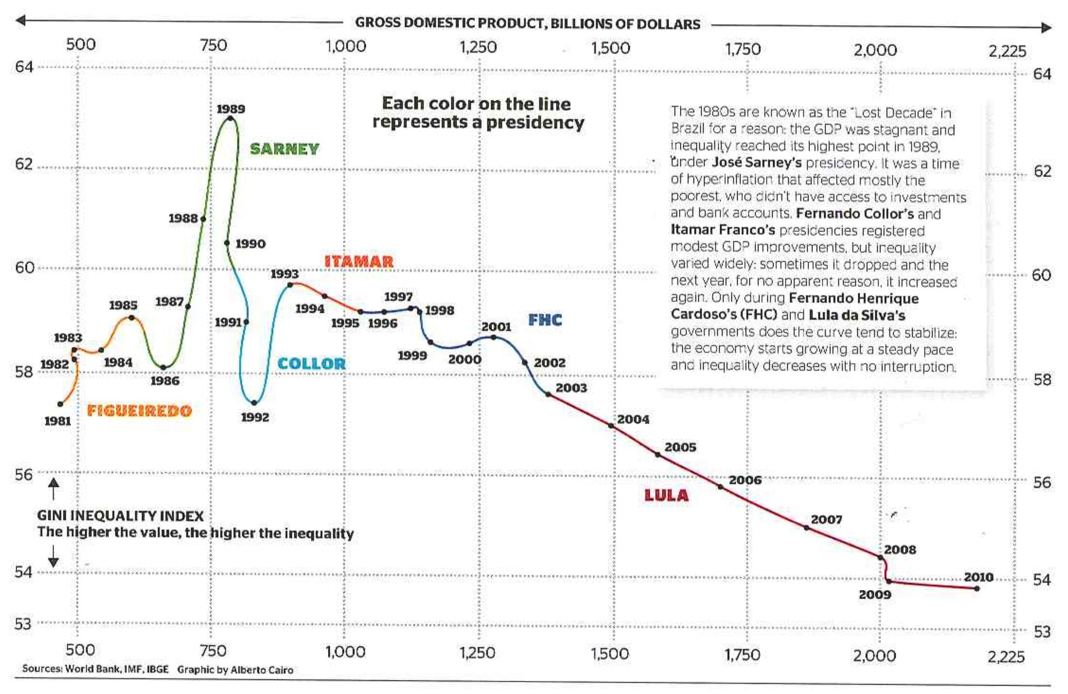
Solution 4: “Interpolated” scatterplot
From Alberto Cairo’s The Functional Art
The overall picture for Brazil is different: there, economic growth over the last 8-10 years has helped reduce inequality (this was not true in its earlier history)

Slide 93
Multiple short time series
Consider making a representation of the survival rates from cancer on different body sites after different number of years.
How does prognosis change over time?
 | 5 years | 10 years | 15 years | 20 years
Prostate | 98.8 | 95.2 | 87.1 | 81.1
Thyroid | 96 | 95.8 | 94 | 95.4
Testis | 94.7 | 94 | 91.1 | 88.2
Melanomas | 89 | 86.7 | 83.5 | 82.8
Breast | 86.4 | 78.3 | 71.3 | 65
Hodgkin's disease | 85.1 | 79.8 | 73.8 | 67.1
Uterus | 84.3 | 83.2 | 80.8 | 79.2
Bladder | 82.1 | 76.2 | 70.3 | 67.9
Cervix | 70.5 | 64.1 | 62.8 | 60
Larynx | 68.8 | 56.7 | 45.8 | 37.8
Rectum | 62.6 | 55.2 | 51.8 | 49.2
Kidney | 61.8 | 54.4 | 49.8 | 47.3
Colon | 61.7 | 55.4 | 53.9 | 52.3
Non-Hodgkin's | 57.8 | 46.3 | 38.3 | 34.3
Pharynx | 56.7 | 44.2 | 37.5 | 33
Ovary | 55 | 49.3 | 49.9 | 49.6
Leukemia | 42.5 | 32.4 | 29.7 | 26.2
Brain | 32 | 29.2 | 27.6 | 26.1
Multiple myeloma | 29.5 | 12.7 | 7 | 4.8
Stomach | 23.8 | 19.4 | 19 | 14.9
Lung and bronchus | 15 | 10.6 | 8.1 | 6.5
Esophagus | 14.2 | 7.9 | 7.7 | 5.4
Liver | 7.5 | 5.8 | 6.3 | 7.6
Pancreas | 4 | 3 | 2.7 | 2.7

Slide 94
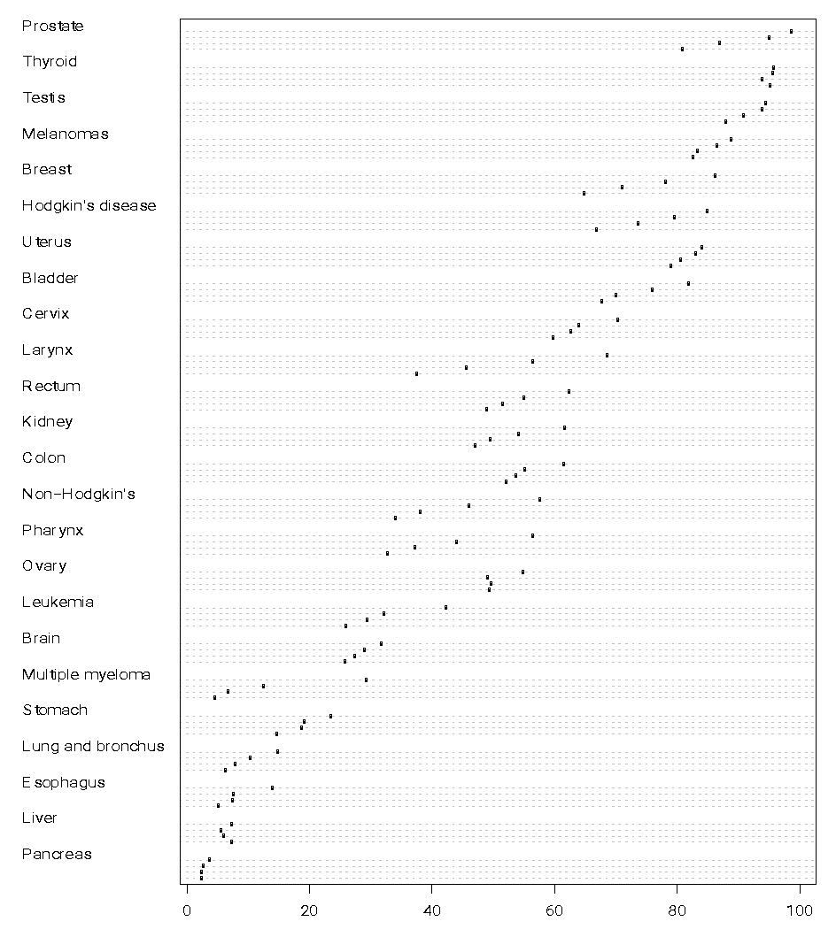
Solution 1: Dot plots
A typical dot plot for this data is somewhat hard to read because
It is very dense (I could not even label the second level).
We are used to think of time as left to right, not up and down (we would need to rotate the graph).
Even rotated, we use dots rather than lines, which are hard to follow.
The natural alternative (grouped bar plots) are not much better.

Slide 95
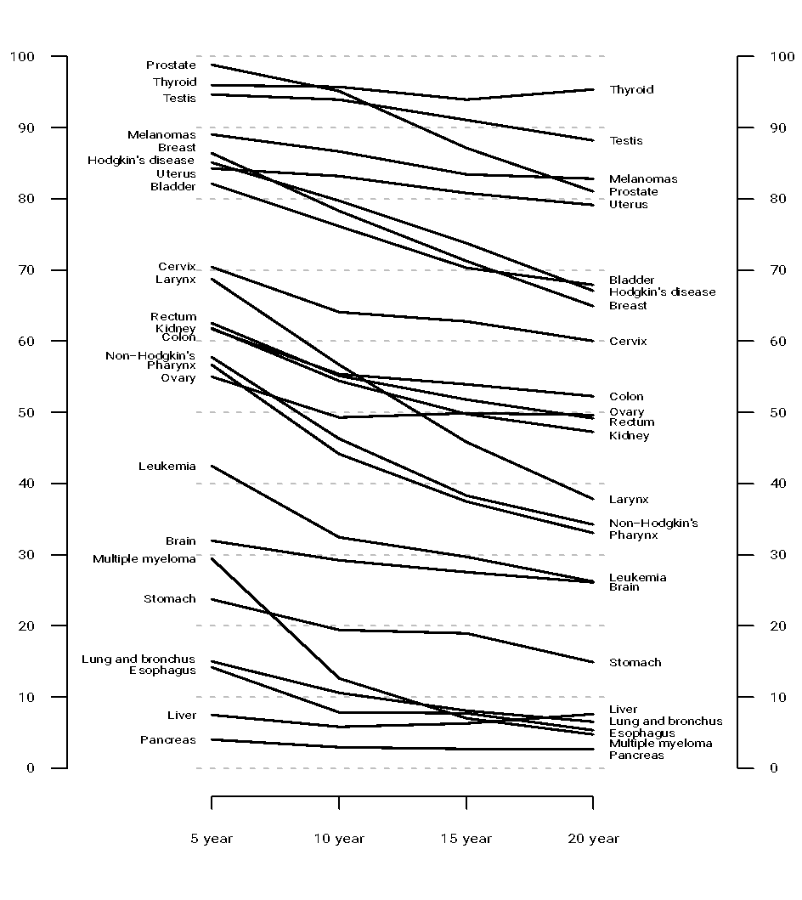
Solution 2: Slopegraph
Because the slopegraph uses lines, trends for each cancer site are very clear.
Labels on both sides are helpful for distinguishing lines that are very close together.
Rankings after 5 and 20 years can be read directly from the graph.

Slide 96
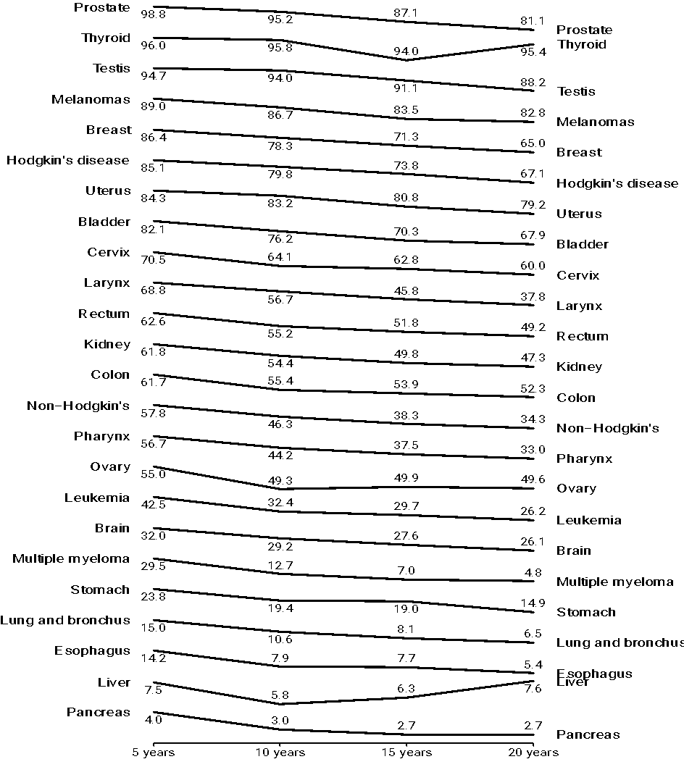
Solution 3: Stacked sparklines
In this case the staked sparklines provide the relevant information about trends, but comparisons across cancers become difficult.
By ordering the sites according to the 5 year survival we get a rough sense of the ranking of risks.

Slide 97
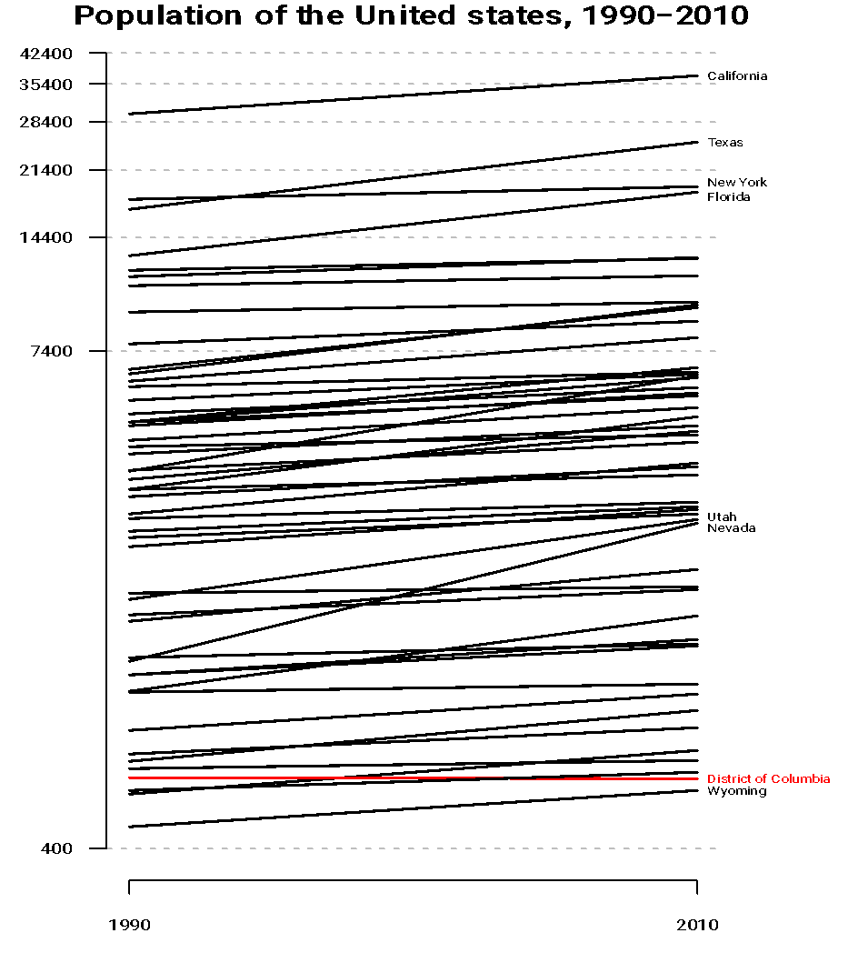
Another example of slopegraphs
Change in population of the different states between 1990 and 2010.
Only Washington DC has lost population!
California still the largest and Wyoming still the smallest.
Some states have grown dramatically (e.g., Nevada).

Slide 98
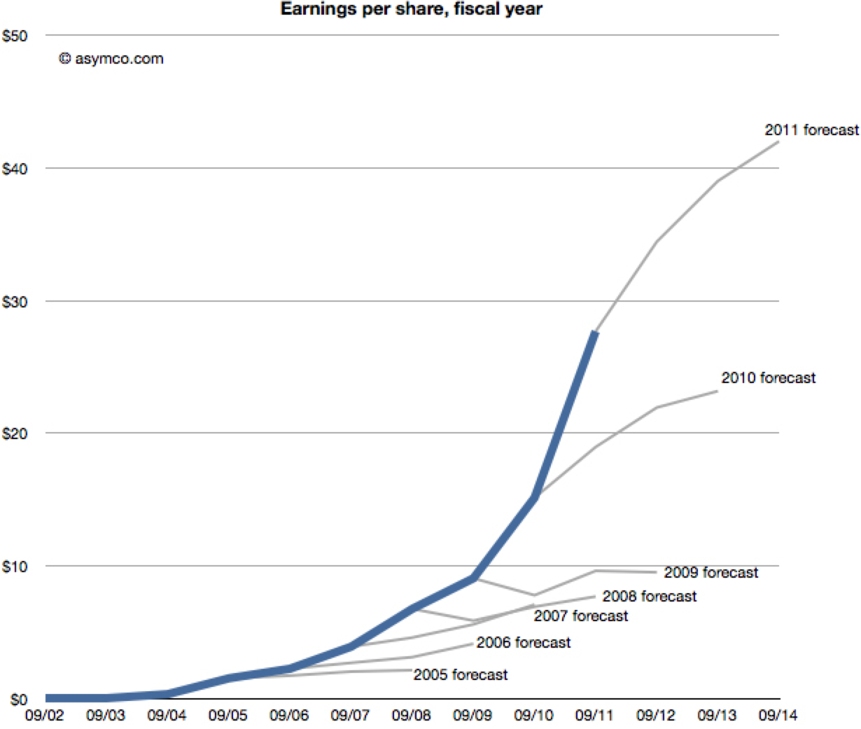
A variant of slopegraphs …

Slide 99

Another variant of slopegraphs

Slide 100
COMPARING RANKINGS

Slide 101
Comparing ranks
Outcomes in some cases are given in terms of orders or priorities.
Ben Fry’s baseball example:
Teams are ranked by wins and loses.
They can also be ranked by expenditure.
Is the amount of money a team spends (e.g., on player salaries) a driver of team success?
Note that we do not care about the actual numbers, just about the ranking.

Slide 102

Solution: Ranked line plot
Looks similar to a slope graph, but it is not!
The position of the team on the vertical scale reflects the order, but not the actual value (they are equally spaced rather ).
Think about building a slopegraph, and then spacing it equally.
Color and thickness of lines helps visualize performance.

Slide 103
Solution: Rank line plot
A prettier and interactive version can be seen at this website:
http://fathom.info/salaryper
How to deal with ties in the ranking is an issue. Here it is probably naturally to break ties scoring by ranking higher the team that spends less money.

